Slide 1
LIGHTNING FAST MOBILE, INC.
+27837 3863
lightningfastmobile@gmail.com lf@mobile.com

Slide 2
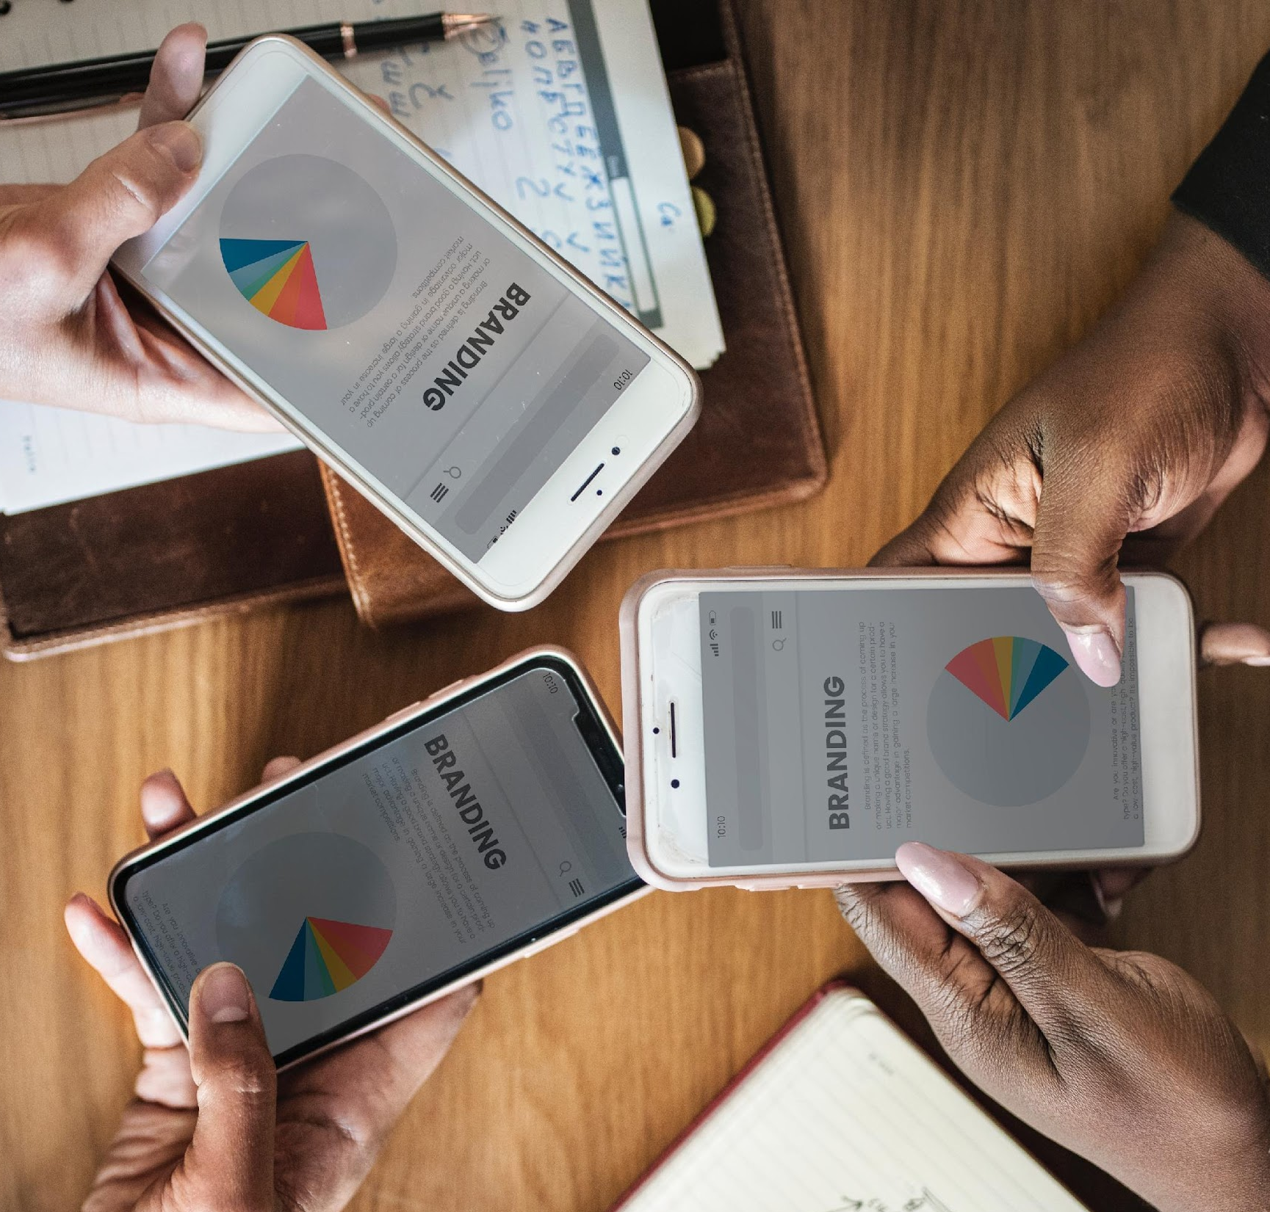
AGENDA
01
PC 2 MOBILE
3.0 MOBILE
02
ANNUAL BOARD MEETING
03

Slide 3
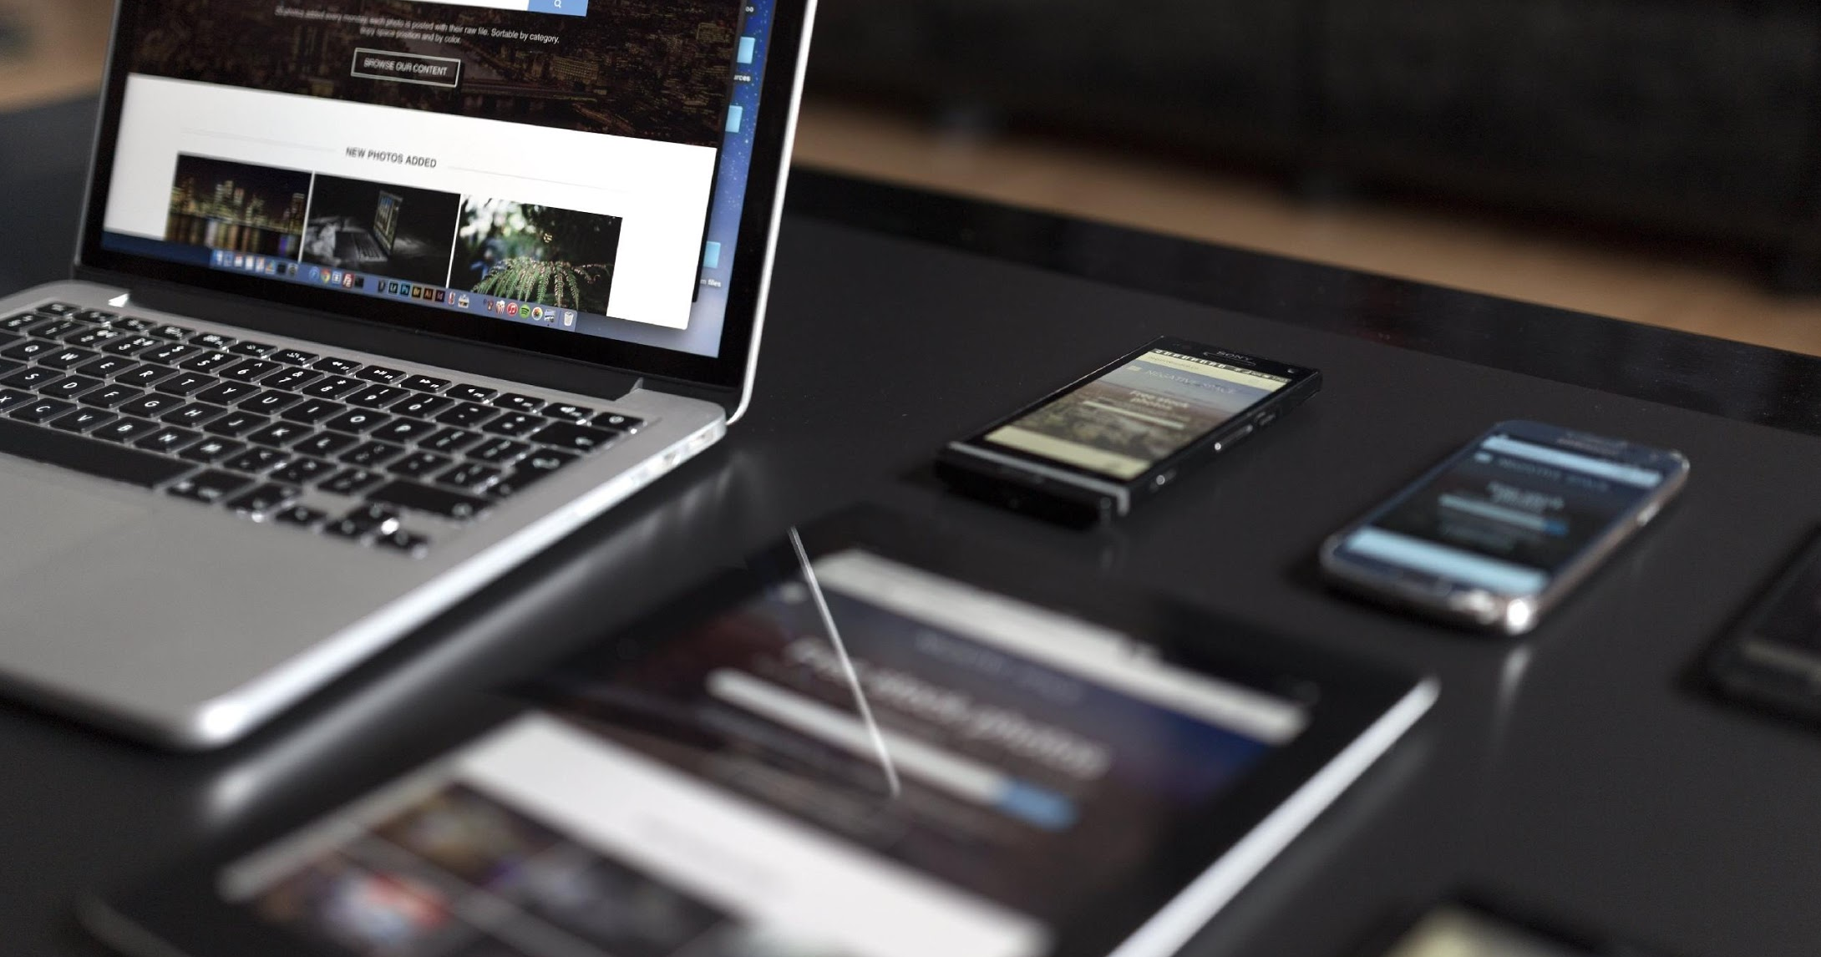
01
PC 2 MOBILE
This will be held at the JGC Mall on December 12, 2021 from 10am to 9pm. Tickets start at only $5 and will entitle all attendees with exclusive discounts on selected products. 70% of the profits from this one day event will be donated to the Feeding Kids International foundation while the remaining 30% will be used for “Save Trees Now!”, an organized project of the Local Government of California.

Slide 4
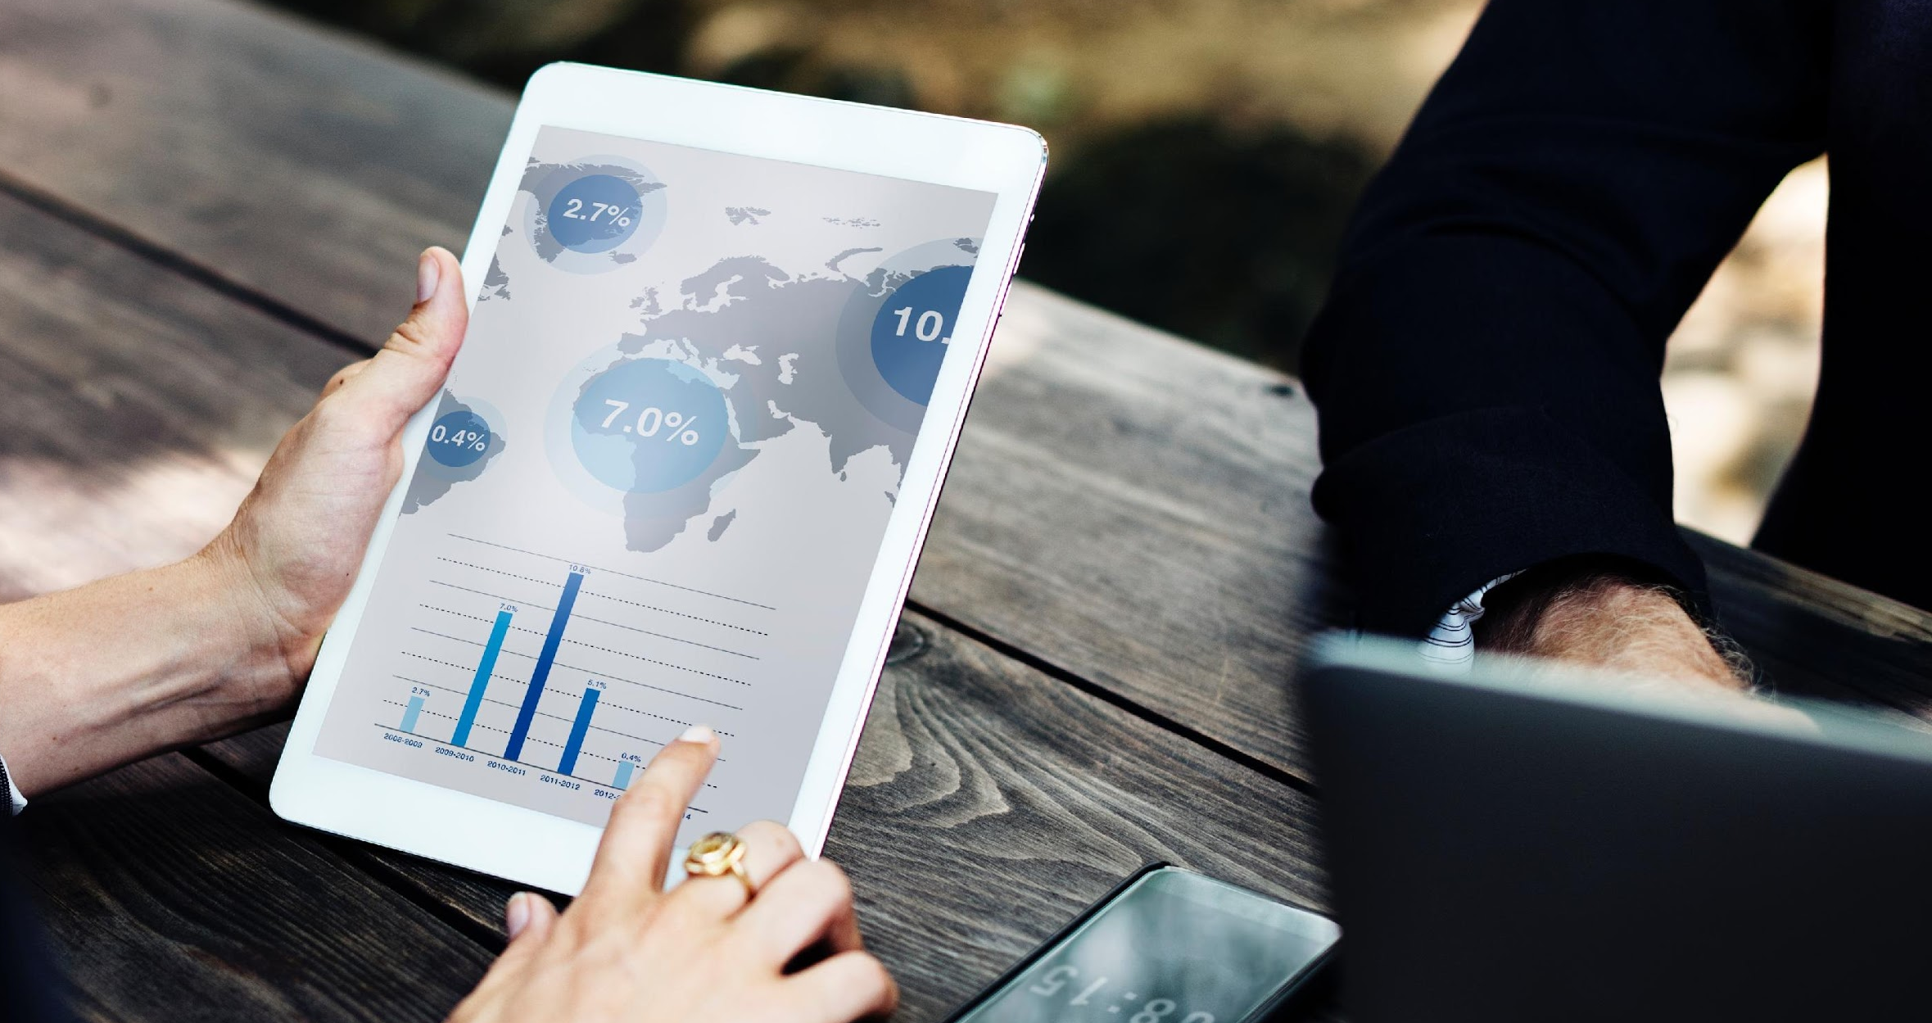
02
3.0 MOBILE
This 3 day expo will be held at the Open Gate Convention Hall side on December 15, 2023 to December 18, 2023 from 10am to 9pm and will showcase the new generation of 3.0 Mobile products developed by Lightning Fast Mobile, Inc. Tickets start at $20 and will entitle all attendees to a free mobile kit and special discounts on selected products. 60% of profits will be donated to the Local Government Units of California while 40% will be used to develop and improve the services and performances of the Lightning Fast Mobile, Inc.

Slide 5
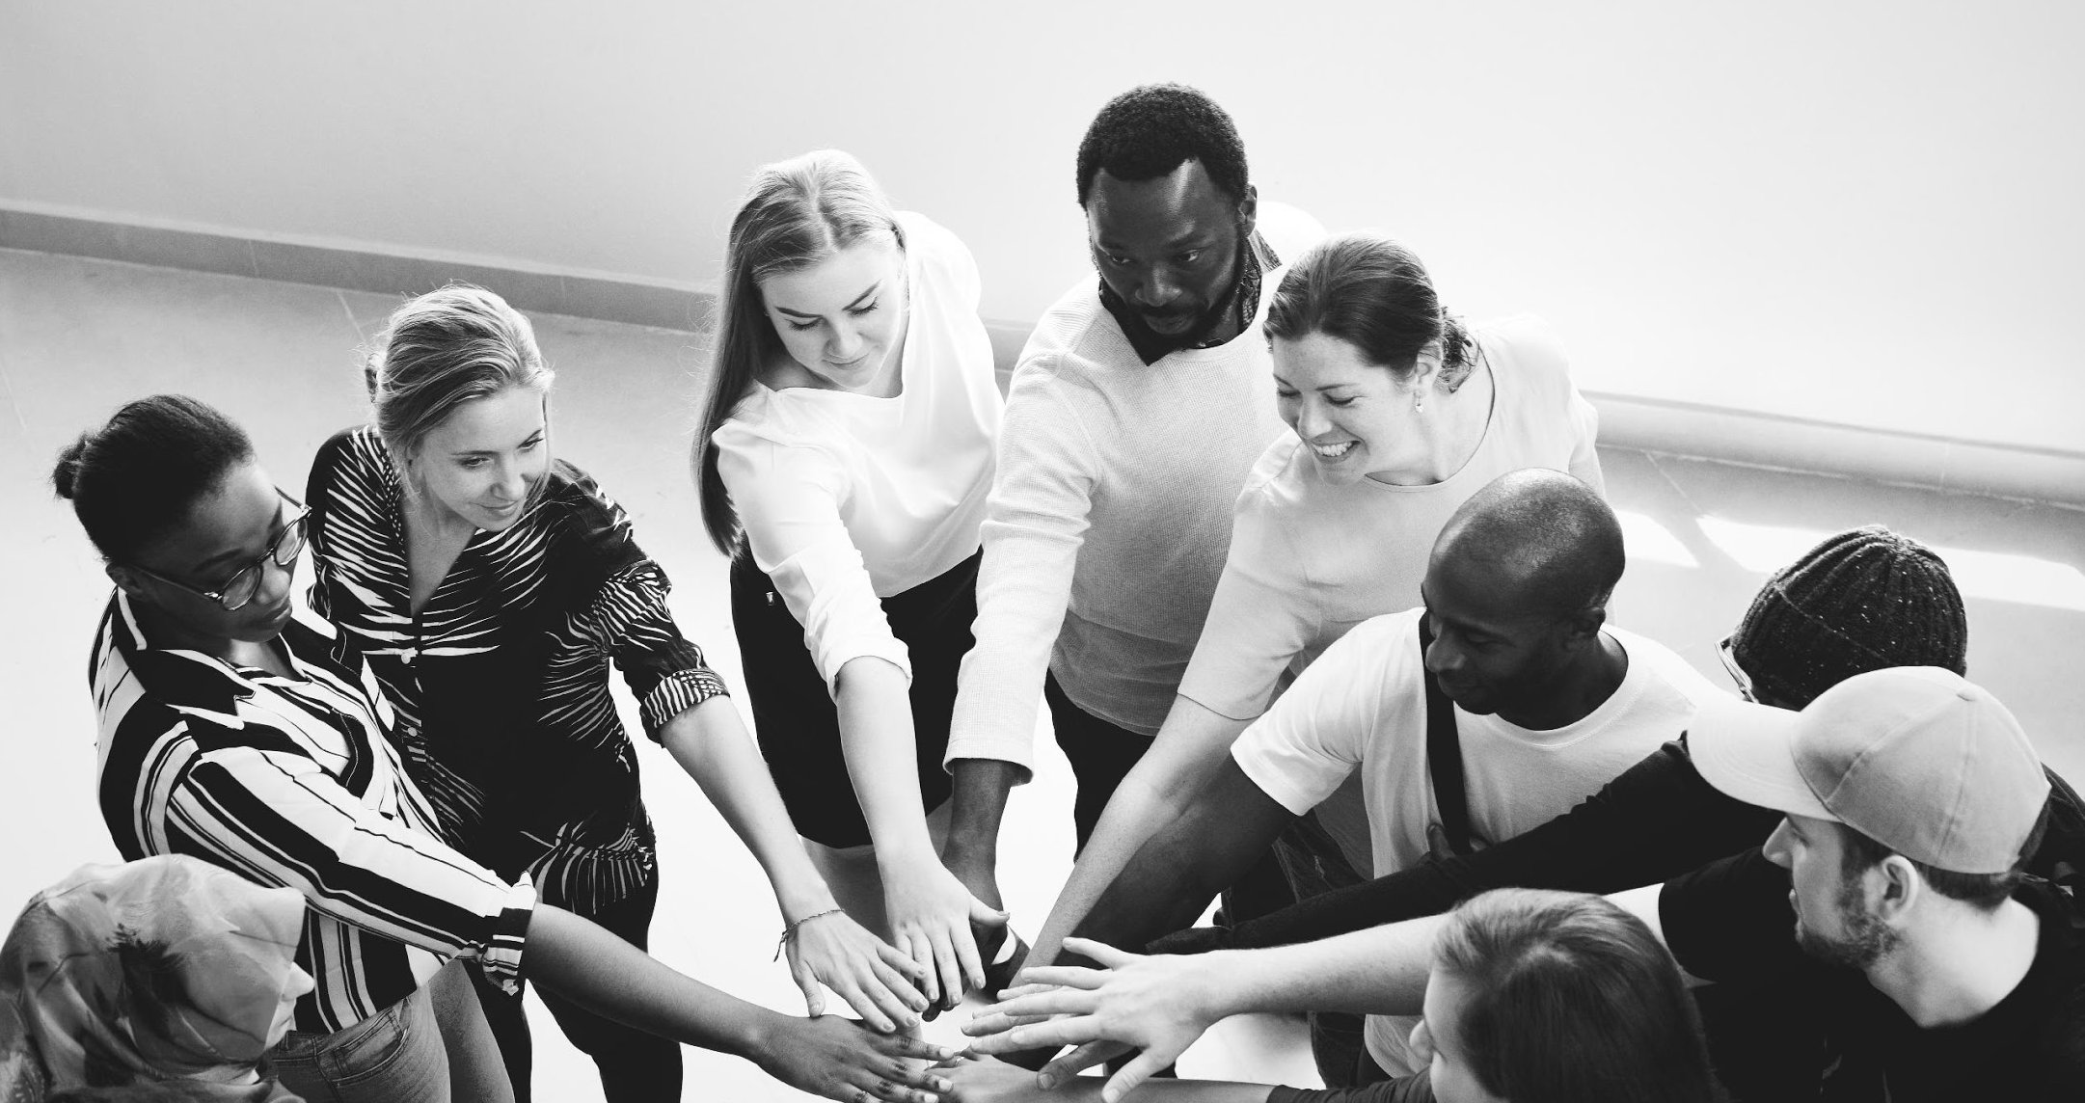
03
ANNUAL BOARD MEETING
Members of the Board will be having their annual monthly meeting at the LF Conference Room on January 15, 2020 from 12pm to 6pm. This meeting will discuss the company’s future plans, products and events this coming 2025 to 2030 as well as the careful and strategic planning and reviewing of the company’s recent status and performance in order for the company’s stabilization, marketing impact, profit and company’s stock boost to be implemented in the early 2022.

Slide 6
Dmitri Bowers
Chairman & CEO
I am pleased to introduce you the most reliable mobile provide, Lightning Fast Mobile, Inc. This corporation showcases the collective sentiment of clients who are in need of the best and perfect mobile devices available at affordable prices.
During our first 5 years as a mobile provider business, Lighting Fast, Inc. faced a lot of challenges and problems which has helped make this company more resilient. Today, it is running on its 17th year in the mobile provider industry in Los Angeles, California.
In order to express our sincere gratitude to our loyal clients and faithful investors, we are pleased to announce our newly developed products that will be promoted and showcased in our organized expo and events.
Furthermore, as a company that aims to become the top mobile provider, Lightning Fast, Inc. will strive further to give all of our beloved clients the best services that our company can offer.

Slide 7
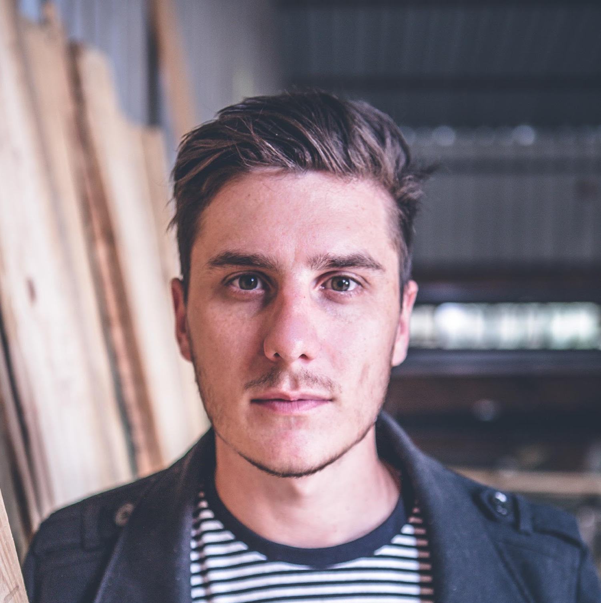
TESTIMONIALS
“We are striving to become the best and most reliable phone provider for all phone enthusiasts.”
-Dmitri Bowers
“Striving to become the best and most reliable phone provider for all phone enthusiasts.”
-Evan Theiseb
“Most reliable phone provider for all phone enthusiasts.”
-Jonathan Evek

Slide 8
HISTORY
First established in 2001 by Dmitri Bowers, Lightning Fast, Inc. is a company that provides you the most reliable mobile products in California. With over 17 years of experience, Lightning Fast, Inc. has become one of the leading businesses in terms of providing quality assured mobiles.

Slide 9
“
We are striving to become the best and most reliable phone provider for all phone enthusiasts.“We are striving to become the best and most reliable phone provider for all phone enthusiasts.”
TESTIMONIALS
-Mhar Dehrehr, 21, Tech Columnist

Slide 10
MAIN GOAL
Lightning Fast, Inc. commits itself to provide the most reliable mobile products and technologically advanced mobile operating systems.

Slide 11
WHAT WE OFFER
01
Free Mobile Cleaning and Check up
03
Platinum Membership Card
02
Affordable Mobile Products
03
Quality Assured & Friendly Customer Care

Slide 12
THE TEAM
Dmitri Bowers
Chairman & Chief Executive Officer
Bie Hoets
Chief Marketing Officer
Casper Holt
Quality Control Officer

Slide 13
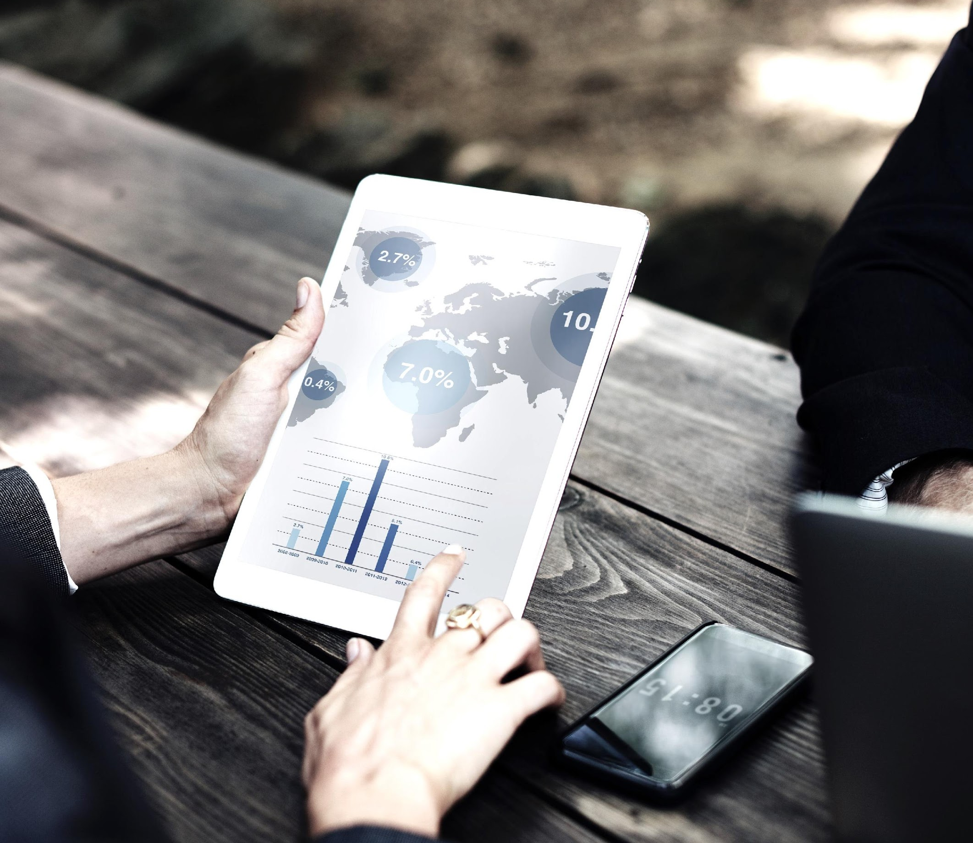
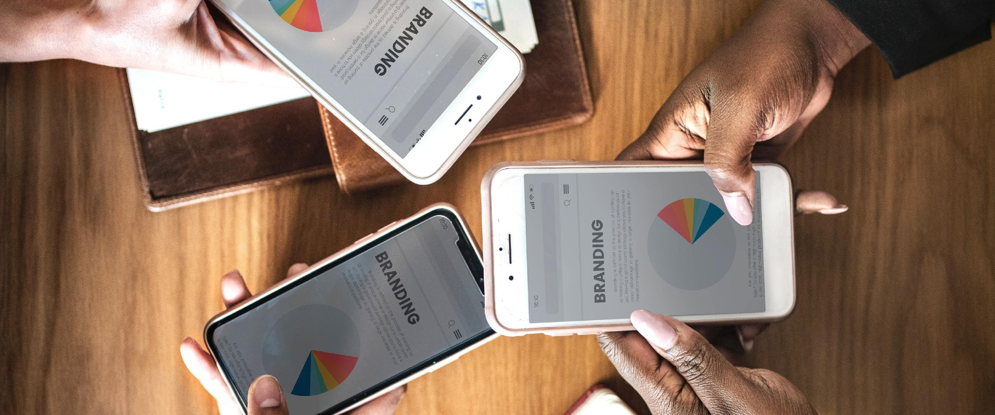
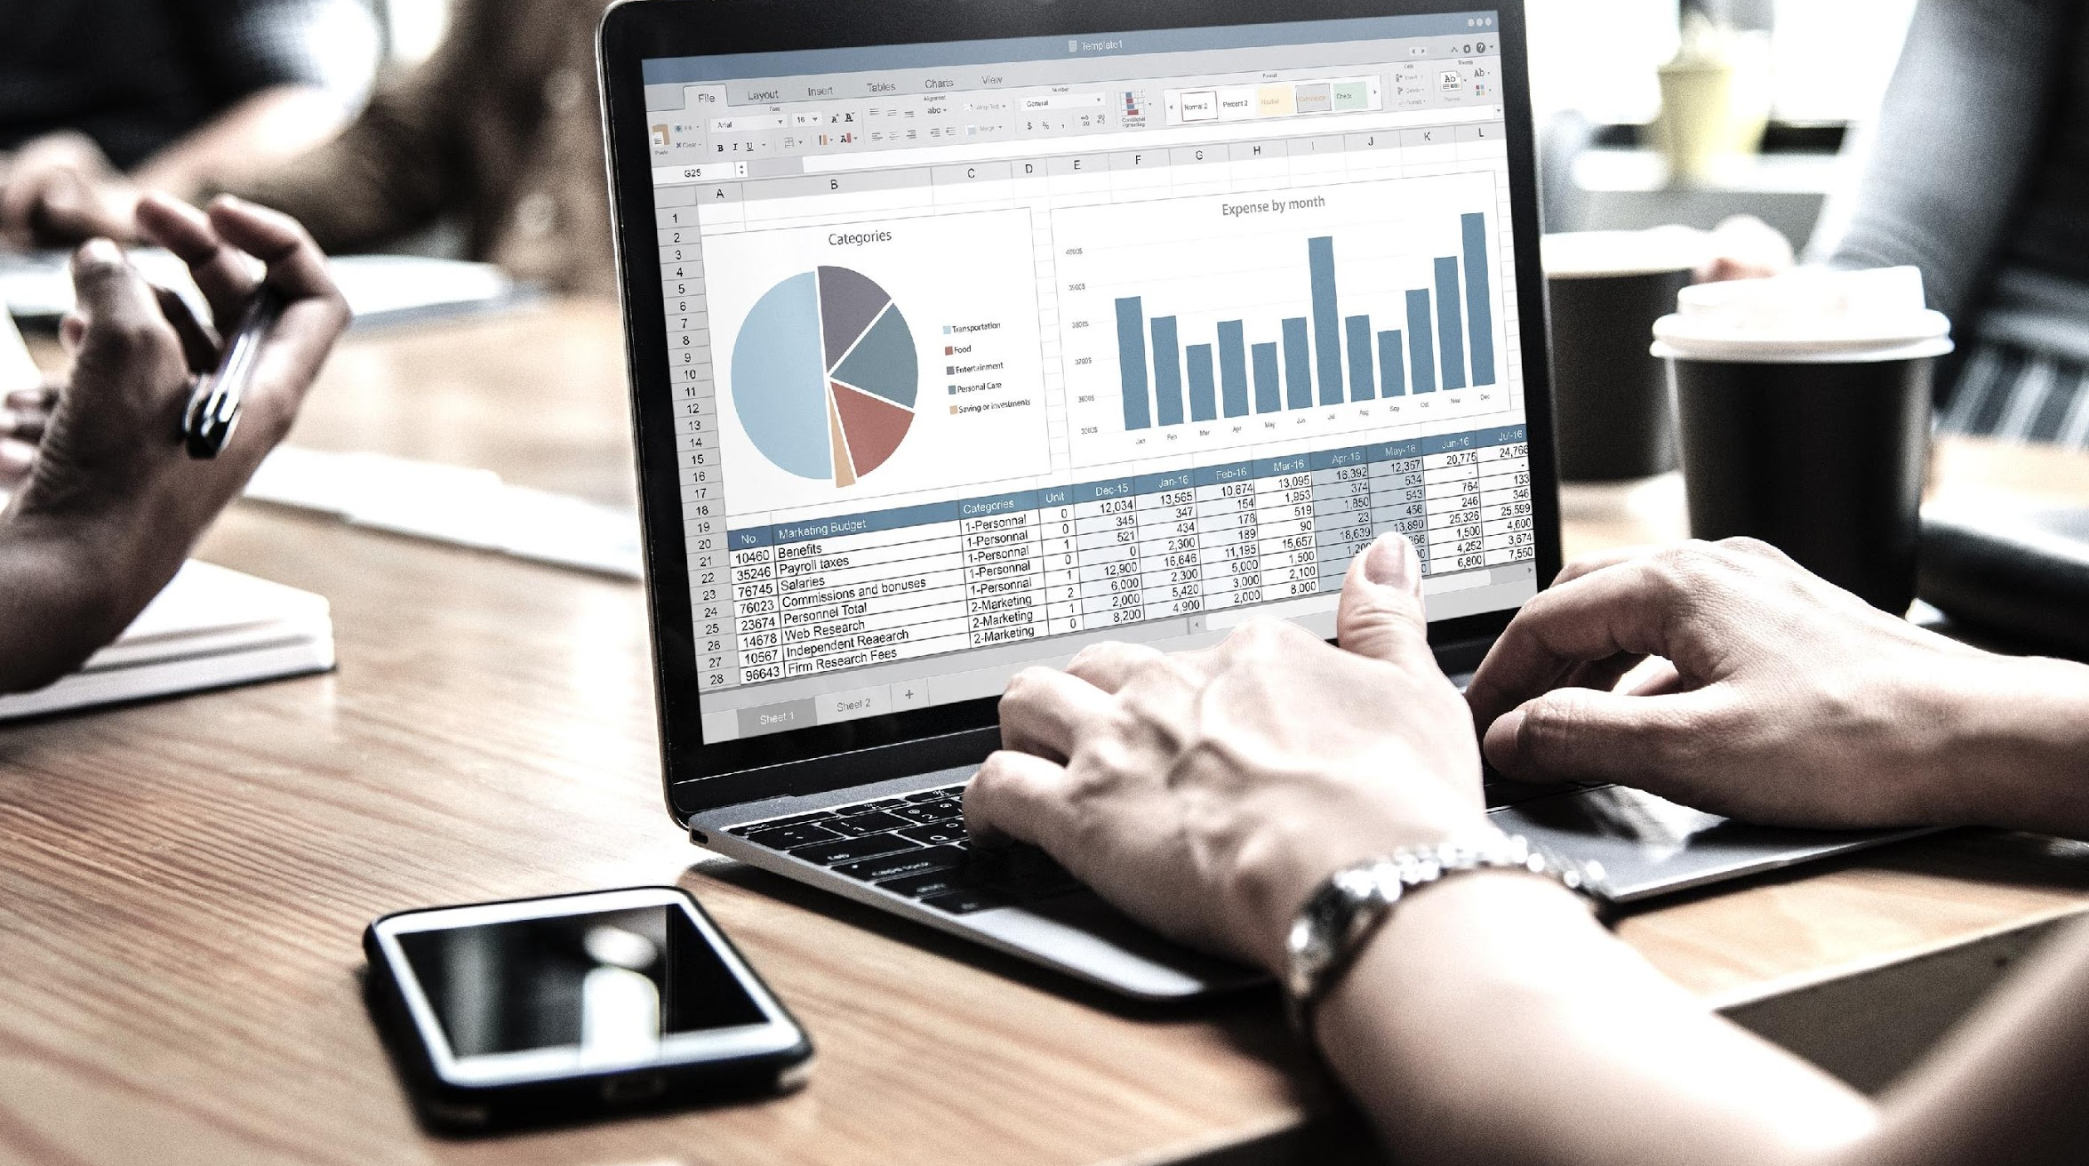
IMAGE
GALLERY

Slide 14
THANK YOU!
+27837 3863
lightningfastmobile@gmail.com lf@mobile.com

