Slide 1
SMARTECH DIGITAL
828 828299 | smart@digital.com

Slide 2
Agenda
ALL AROUND
DIGITAL PRODUCTS
WEBSITE
DESIGN SALE
QUARTERLY
BOARD MEETING
This event will be held held at the Super Malls Grounds on March 19, 2023 from 10am to 9pm. Tickets will start at $20 and will entitle all attendees to discounts on great digital product selections. Profits will be utilized for the office renovation and system upgrade of Feeding America Foundation.
This will be held at the Ground Floor Malls on March 17, 2024 from 10am to 9pm. Tickets will start at $10 and will entitle all attendees discounts as high as 50% off on selected digital marketing products and a free product consultation. 50% of total profits from the event will be used for the system upgrade and office renovation of Smartech Digital.
This is to be held at the Smartech Digital Conference Room on January 10, 2020 from 12pm to 6pm. The agenda of this meeting is to discuss Smartech Digital’s currently handled products and performance. Additionally, this meeting will also allow discussion for the future plans and events aimed to boost the company’s profit, performance and marketing to people in the digital marketing industry.

Slide 3
About
Molly Que
Founder & CEO
This event will be held held at the Super Malls Grounds on March 19, 2023 from 10am to 9pm. Tickets will start at $20 and will entitle all attendees to discounts on great digital product selections. Profits will be utilized for the office renovation and system upgrade of Feeding America Foundation.

Slide 4
Testimonial
“
Smartech Digital never fails to deliver efficient and effective digital marketing materials that any company will want and need!
-Molly Que, 38, Founder & CEO

Slide 5
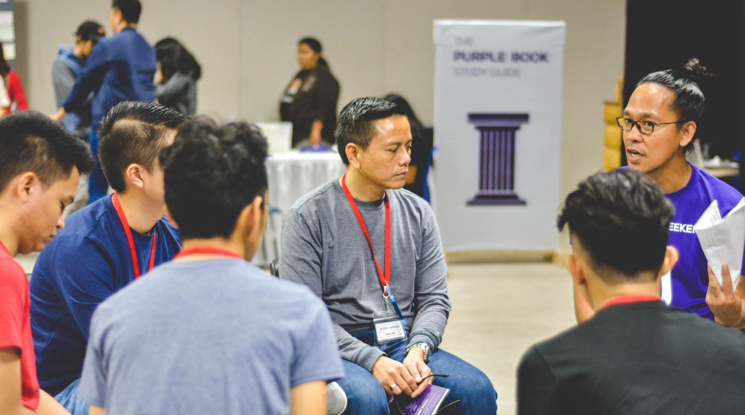
All Around Digital Products
Super Malls Grounds
March 19, 2023 | 10am to 9pm
Tickets will start at $20 and will entitle all attendees to discounts on great digital product selections. Profits will be utilized for the office renovation and system upgrade of Feeding America Foundation.

Slide 6
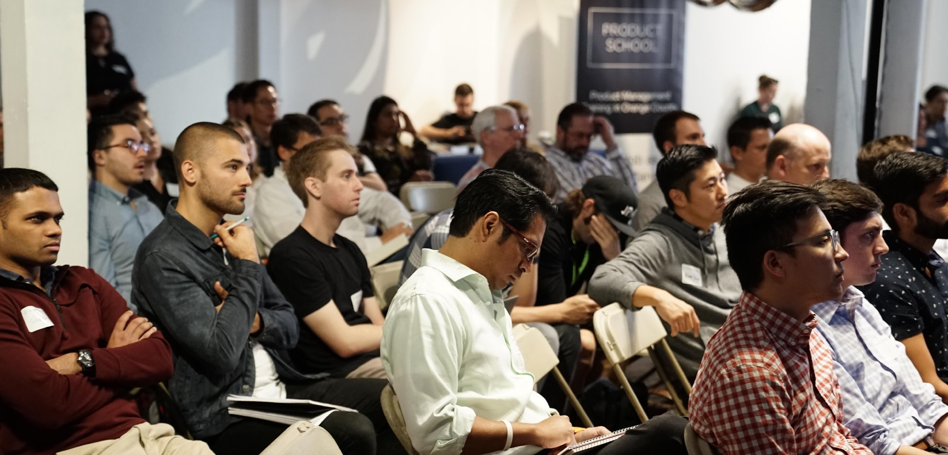
Website
Design Sale
Ground Floor Malls
March 17, 2023 | 10am to 9pm
Tickets will start at $10 and will entitle all attendees discounts as high as 50% off on selected digital marketing products and a free product consultation. 50% of total profits from the event will be used for the system upgrade and office renovation of Smartech Digital.

Slide 7
Quarterly
Board Meeting
Smartech Digital Conference Room
January 10, 2020 | 12pm to 6pm
The agenda of this meeting is to discuss Smartech Digital’s currently handled products and performance. Additionally, this meeting will also allow discussion for the future plans and events aimed to boost the company’s profit, performance and marketing to people in the digital marketing industry.

Slide 8
History
Smartech Digital was a small company started by Molly Que during 2003. Those years were dubbed as “the start of the computer age” since most companies were starting to use digital computers and digital based products as a source of profit and income during that time. Que saw this as an opportunity to provide businesses with digital marketing options to boost their company’s traction.
Today, Smartech DIgital is now approaching 15 years in the digital marketing industry and is planning to expand its name across the country. The company will forever be grateful for those challenges and problems occurred during its early years in the digital marketing industry since it helped the company grow stronger and wiser.

Slide 9
Testimonial
From Guest
“
If you are looking for a company that can give you highly reliable digital marketing products, Smartech Digital can give you just that and morer.
-Steve Browen, 22, Tech Columnist

Slide 10
Main Goal
Smartech Digital commits itself to provide the best and most effective yet affordable digital marketing products in the industry while sticking to its company standards of quality and excellence.

Slide 11
Overview
Of Growth
70%
increase in annual profits as of May 2025
increase in product and packages satisfaction as of March 2023.
50%
40%
increase in clients as of March 2022.

Slide 12
What
We Offer
Great Product Selections
Affordable Digital Marketing Product Packages
Quality Assured Services
Friendly Customer Care

Slide 13
Image
Gallery

Slide 14
The Team
James West
Molly Que
Kane Good
Chief Operating Officer
Founder & CEO
Tech Consultant

Slide 15
THANK YOU
828 828299 | smart@digital.com

