Slide 1
BITZ
SHOES AND FASHION

Slide 2
PRESENTATION REPORT
BITZ
POTENTIAL CUSTOMERS REPORT
SHOES@BITZ.COM
The Potential Customers Report will be held at the Bitz Shoes & Fashion Meeting Room on March 15, 2023, from 12 PM to 6 PM.
The report shows that high school & college students contribute to a large factor of being a potential buyer & customer of Bitz Shoes & Fashion which could be a potential factor of increase in the company’s sales & performance.

Slide 3
Jenny Newman Garnet
BITZ
Chairman & CEO
ABOUT
As the chairman, CEO and one of the founding members of the shop, I am proud to introduce you to the new & improved Bitz Shoes & Fashion.
Bitz Shoes & Fashion started its operation in 2002 as a small shop having only $500 as a starting capital & only 15 different offered products in the market. The shop faced lots of trials and challenges due to the extreme competition in the fashion service industry.However, Blitz Shoes & Fashion found its success and breakthrough when its products were featured & used in an international modeling & fashion show which paved for the shop to be recognized by lots of firms & individuals in the market.
SHOES@BITZ.COM

Slide 4
TESTIMONIALS
“As a longtime officer of Bitz Shoes & Fashion, we always ensure that the quality & excellency of products that we sold in the market showcases our shop’s dedication & honor in the business. Visit us now & experience the best jewels & fashion products available.”
-Ruby Crest Newman, 37, Chief Finance Officer

Slide 5
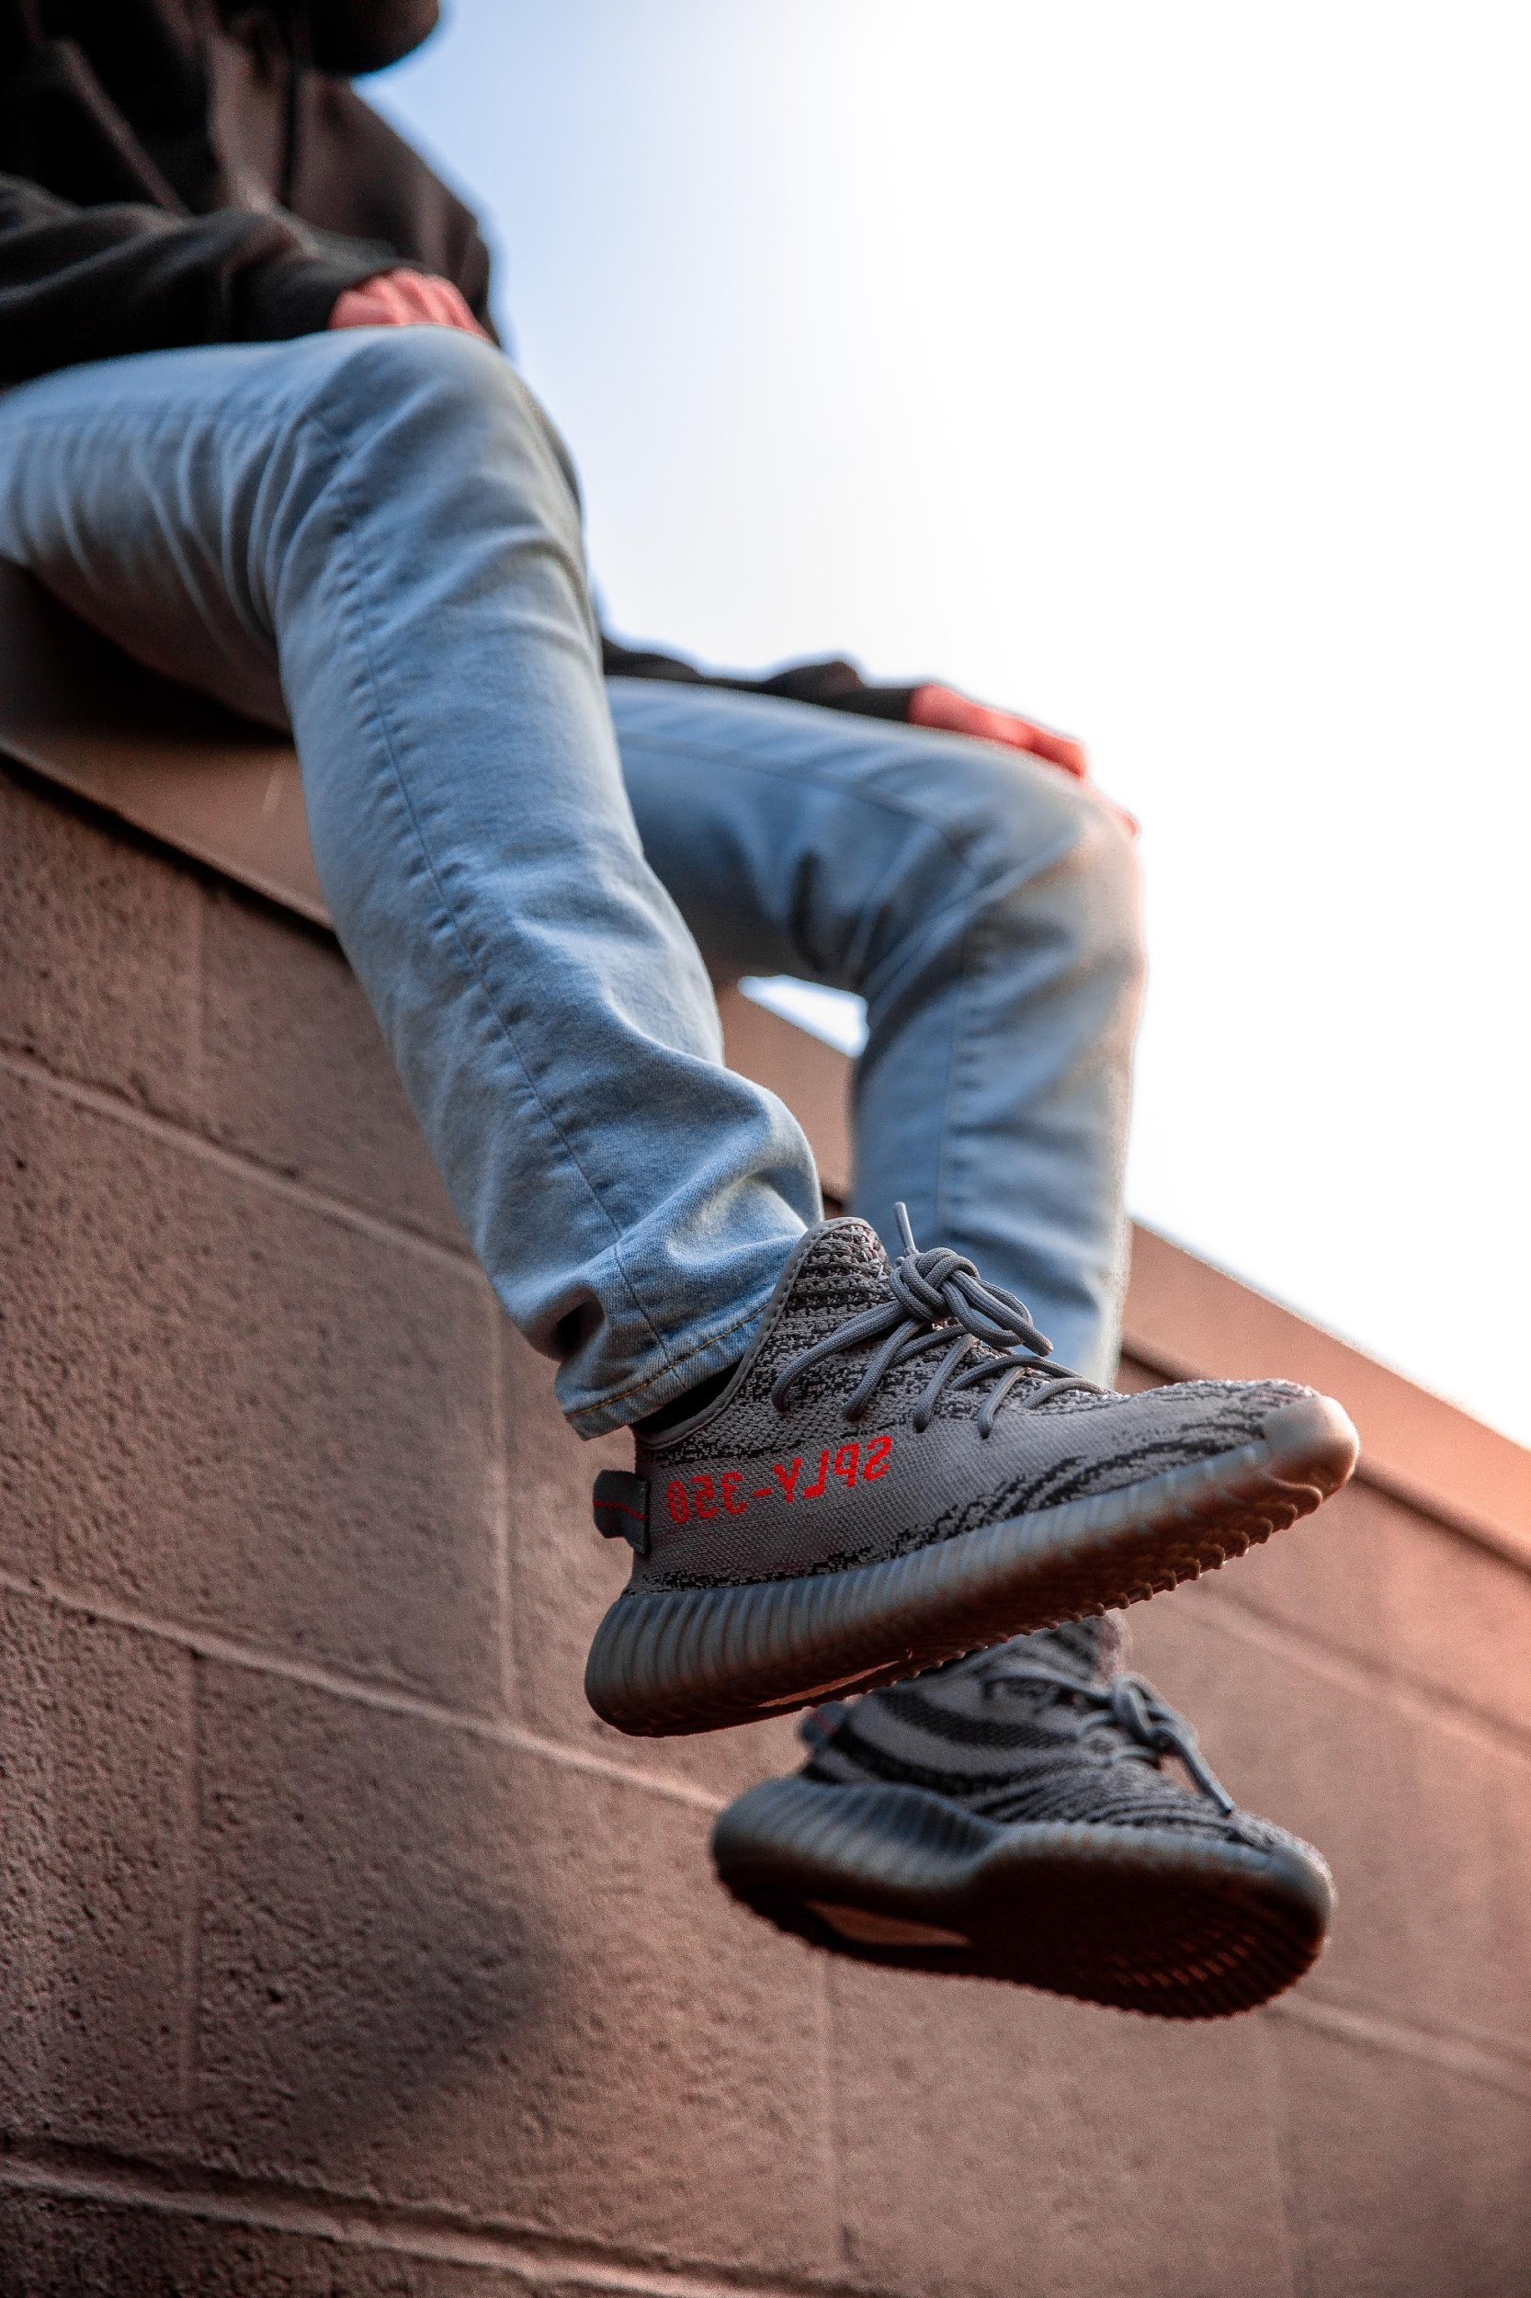
POTENTIAL CUSTOMERS REPORT
Bitz Shoes and Fashion Meeting Room
SHOES@BITZ.COM
March 15, 2023 | 12 PM to 6 PM
From January to February 2023, the potential customers that are shoes & fashion enthusiasts are ages from 16 to 33. The tentative output shows that up to 60% of the increase in sales and accumulated profits can be generated if the majority of the potential buyers choose Bitz Shoes and Fashion, the 60% increase can be converted to up to $900, 000 of sold products & gained over 3 months of operation. The projected profits accumulated from this report will be allocated for the budget for the company’s performance in the year 2024 which will then be used for the newly developed marketing strategy of the company aimed to promote & market the products locally.

Slide 6
POTENTIAL COMPETITORS REPORT
SHOES@BITZ.COM
Blitz Shoes and Fashion CEO Meeting Room
March 10, 2023 | 12 PM to 6 PM
From January to February 2023, the potential customers that are shoes & fashion enthusiasts are ages from 16 to 33. The tentative output shows that up to 60% of the increase in sales and accumulated profits can be generated if the majority of the potential buyers choose Bitz Shoes and Fashion, the 60% increase can be converted to up to $900, 000 of sold products & gained over 3 months of operation. The projected profits accumulated from this report will be allocated for the budget for the company’s performance in the year 2024 which will then be used for the newly developed marketing strategy of the company aimed to promote & market the products locally.

Slide 7
PRODUCT ANALYSIS
Bitz Shoes and Fashion CEO Meeting Room
March 13, 2023 | 12 PM to 6 PM
SHOES@BITZ.COM
The store will showcase a new product called “Jewels & Bits” which will feature lots of excellently made jewelry intended for personal & fashion use that will be sold for as low as $99.99. If successful, the company’s projected sales for the run & performance of the product during its availability in the market be up to $50, 000 - $90, 000 which can be allocated to the planned marketing strategy & promotion of the product for the year 2023 to 2024.

Slide 8
The tentative output shows that up to 60% of the increase in sales & accumulated profits can be generated if the majority of the potential buyers choose Bitz Shoes & Fashion, the 60% increase can be converted to up to $900, 000 of sold products & gained for the first 3 months of operation. The projected profits accumulated from this report will be allocated for the budget for the company’s performance in the year 2024 which will then be used for the newly developed marketing strategy of the company aimed to promote & market locally thae products.
SHOES@BITZ.COM

Slide 9
TESTIMONIALS FROM CLIENTS
“I am always happy & satisfied with my purchases at Blitz Shoes and Fashion. They do their best to give the best fashion products available in the market. I highly recommend this shop to all individuals who are looking for a good shop that offers excellent quality jewelry & fashion.”
-Caroline Tangerine Smith, 28, Fashion Model and Blogger

Slide 10
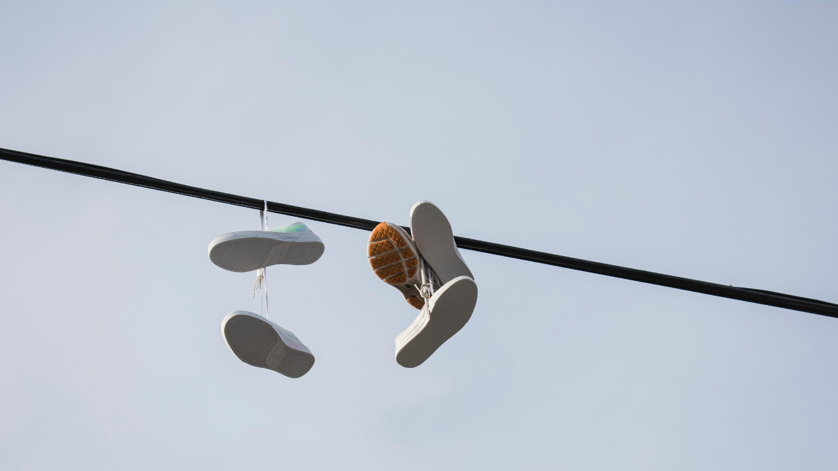
MAIN GOAL
Blitz Shoes & Fashion commits itself towards producing excellent quality jewelry & fashion by serving our beloved & valued customers with trendy pieces.
SHOES@BITZ.COM

Slide 11
OVERVIEW OF GROWTH
50%
increase in annual profits as of December 2022.
SHOES@BITZ.COM
60%
increase in customer satisfaction with produced products as of March 2024.
60%
increase in shops sold products in the market as of March 2023.

Slide 12
WHAT WE OFFER
SHOES@BITZ.COM
Lots of Amazing Products & Promos
On Trend Jewelry
Excellent Fashion Pieces
Friendly Customer Care & Service

Slide 14
THE TEAM
SHOES@BITZ.COM
Jenny Newman Garnet
Sapphire Red Cressman
Ruby Crest Newman
Founder & CEO
Chief Operating Officer
Chief Marketing Officer

Slide 15
THANK YOU!
+383 3820203 | shoes@bitz.com

