Slide 1
Best Travel Inc.
_{Columbia, MD 281, USA}

Slide 2
The Company
About
Best Tavel, Inc. is a travel company that offers travel & tour packages around the globe. Located in Columbia, Maryland, it’s one of the major travel companies in the city that offers affordable travel services.
Best Travel, Inc. aims to give its clients their great escapade through a luxurious tour to their desired travel destination.

Slide 3
The Company
Vision
Best Travel, Inc. aims to deliver an exceptional service by providing customers their desired travel service in any part of the world.
We strive to be a caring and well-managed organization for our business
partners ,customers and employees, and a responsible corporate citizen to our society.
Best Travel, Inc. incorporates its strength in operation by applying integrity, honesty & efficiency in order to achieve its goal of providing the best service to clients.

Slide 4
The Company
Mission
To innovate, to lead, to enhance, to provide best-value products and services to global customers. To make a difference and To enhance the quality of life for our business partners,customers and employees. Best Travel, Inc. sees itself to becoming the gateway for clients who are dreaming of their perfect getaway.

Slide 5
Team
John Newman
Sapphire Cressman
Ruby Crest
Founder & CEO
Chief Operating Officer
Chief Marketing Officer

Slide 6
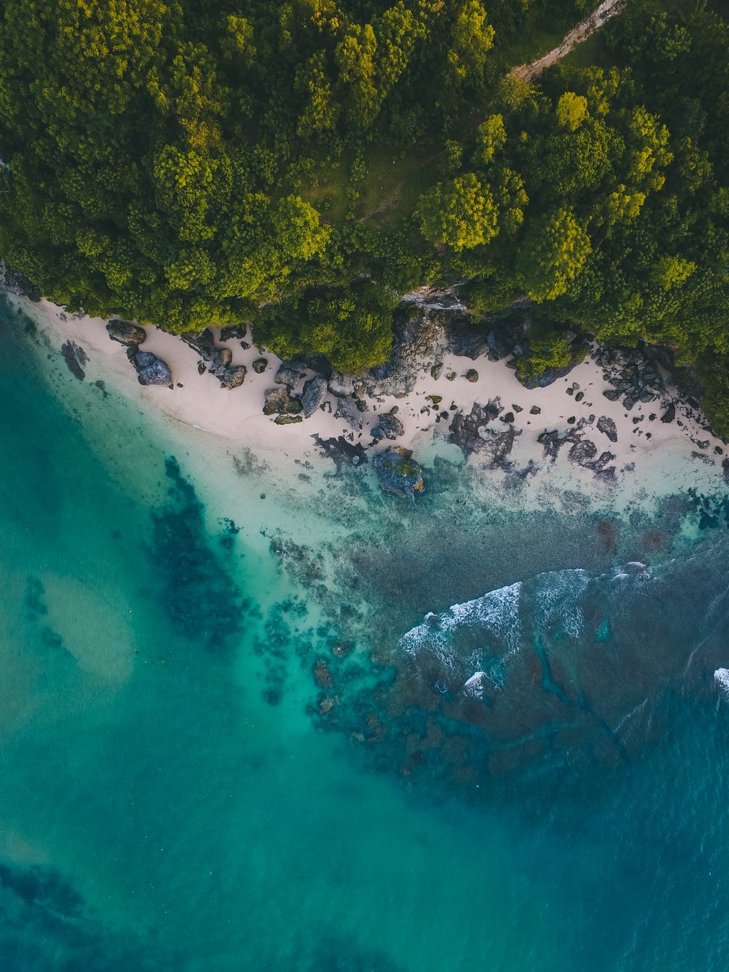
Execution
Goal
We strive to be a caring and well-managed organization for our business partners , customers and employees, and a responsible corporate citizen to our society.
Travel is one of the top industries in every country that profits off of those individuals excited to discover new places around the world. Traveling agencies therefore prioritize:

Slide 7
Execution
Value Proposition
Clients seeking a trusted, affordable traveling company. Clients looking for agencies that will provide cost-efficient traveling options.
Pricing Strategy
Best Travels Inc uses a cost-plus pricing strategy. It is accessible & affordable to more users in the target demographic.

Slide 8
Operation Plan
Marketing Analysis
Marketing for travel and tourism operations involves designing advertisements or promotional offers that will best draw customers toward a travel business. In order to do this well, marketers conduct surveys or interviews with target consumers in order to establish their needs, what they respond to and what they look for when choosing such an organization. Marketers must then be able to use this information to draft successful campaigns that increase business and profits. In order for tourism businesses to succeed, they rely on marketing professionals to link potential consumers with their services and operations.

Slide 9
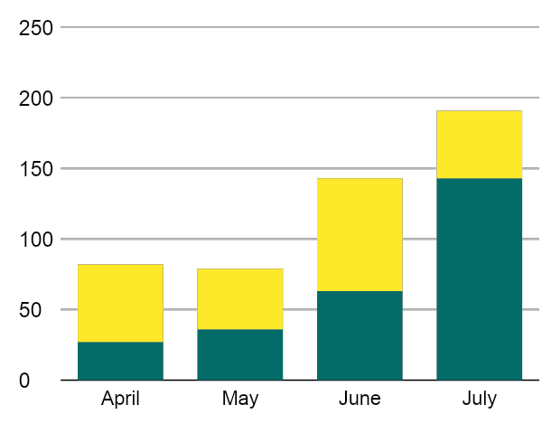
Operation Plan
Analytics
Focuses on target audience through social media & printed flyers.
Advertising the perfect travel package for clients who are interested in tour & travel.
Effectively engaging with potential clients.
Coats
A pioneer in promoting tourist destinations Best Travel has since become a full-pledged travel agency specializing in the development of both inbound and outbound tour products for corporate incentives
^{and leisure tours.}
Dress
Jeans
Lingerie

Slide 10
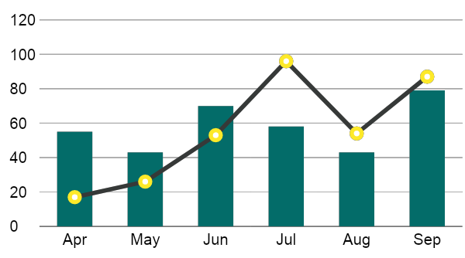
Operation Plan
Growth Overview
There is an increase in annual profits as of April 2022. There is an increase in customer satisfaction with produced products as of June 2024. Also there is increase in Tickets sold in the market as of March 2023.

Slide 11
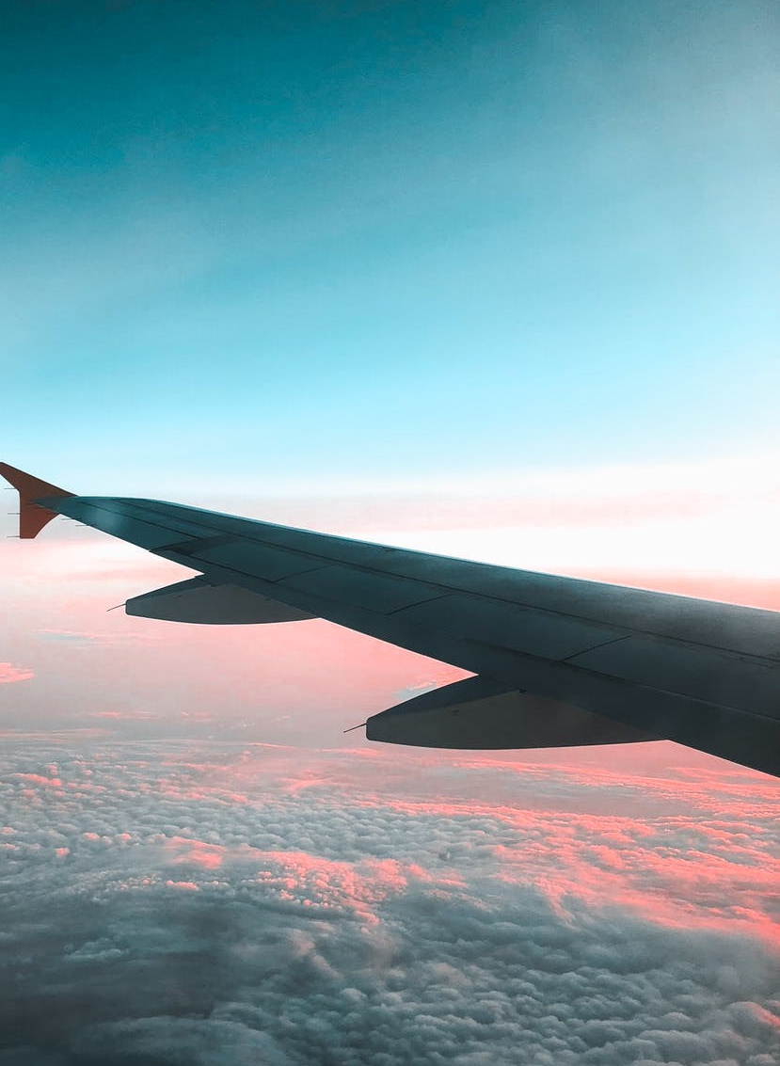
Operation Plan
Organizational
Structure
The CEO of the company is the head of operations. Under the CEO is the Marketing Division Head & Travel Development Division Head.
The head of the Marketing Division is responsible for creating & implementing marketing plans, strategies & market research. The team in this department also manages client concerns & collaborates with the Travel Development division in resolving any design issues.

Slide 12
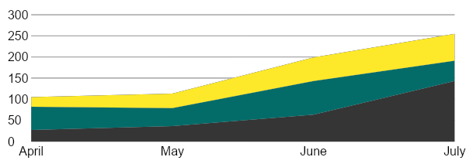
Operation Plan
Customer Satisfaction
The head of the Marketing Division is responsible for creating & implementing Analytic Strategies, & market research.
The team in this department also manages client concerns & collaborates with the Travel Development division in resolving any customer issues.
74.6 %
33.5 %

Slide 13
Operation Plan
Company Milestones
Short-term Goals | Milestones
Social media brand marketing | Reached 50% of audience target.
Company Building Expansion | Construction started 2024
Long-term Goals | Milestones
Partnership with East Coast Travel Tours | Contract signing on February 2027
Brand expansion in New York & New Jersey | Budget proposal drafted as of July 2026

Slide 14
Operation Plan
Outlook
Best Travel Inc. is a duly-licensed travel agency that provides a wide array of services including international and local packages comprising of land arrangement, airline tickets, land transfers and sightseeing tours. The team is composed of travel specialists who are well versed with the complexities of travel and tour.
“
”
Travel to make memories all around the world

Slide 15
Testimonials
Stefan Clothing was a worthwhile investment for me. Knowing that I can’t have many of the things I used to have when I was younger, I needed all the help I could get in style. Now I can with Stefan Clothing”
^{- Cyndia D. Thomas, 53, Nurse}
“My dad isn’t getting any younger. I needed as much assistance as I could in terms of keeping his fashion alongside his medication without having to take up too much of my personal work as well. I’d highly recommend this to any elderly (or those assisting the elderly) any day.”
- Wylang J. Wyans, 32, Engineer

Slide 16
Best Travel Inc.
Thank You

