Slide 1

SALES
Pitch Deck

Slide 2
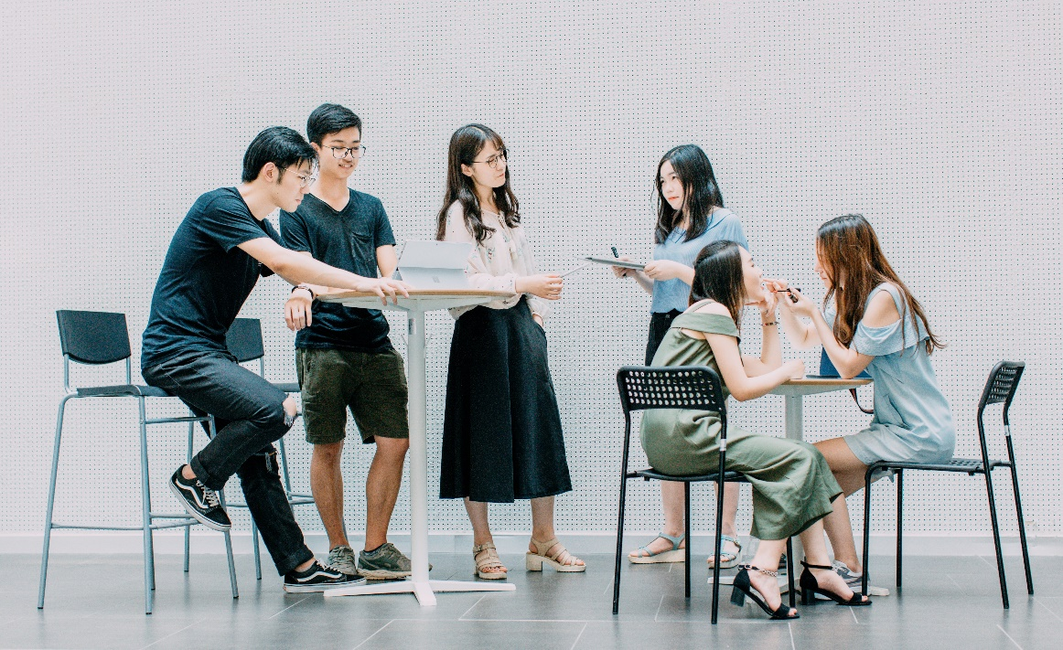
About Us
Comic One is a pop culture merchandise store based in San Diego, California specializing in action figures and stuffed toys. Active since 1990, it was founded by Zeno Bay who was a comic book writer and co-player.

Slide 3
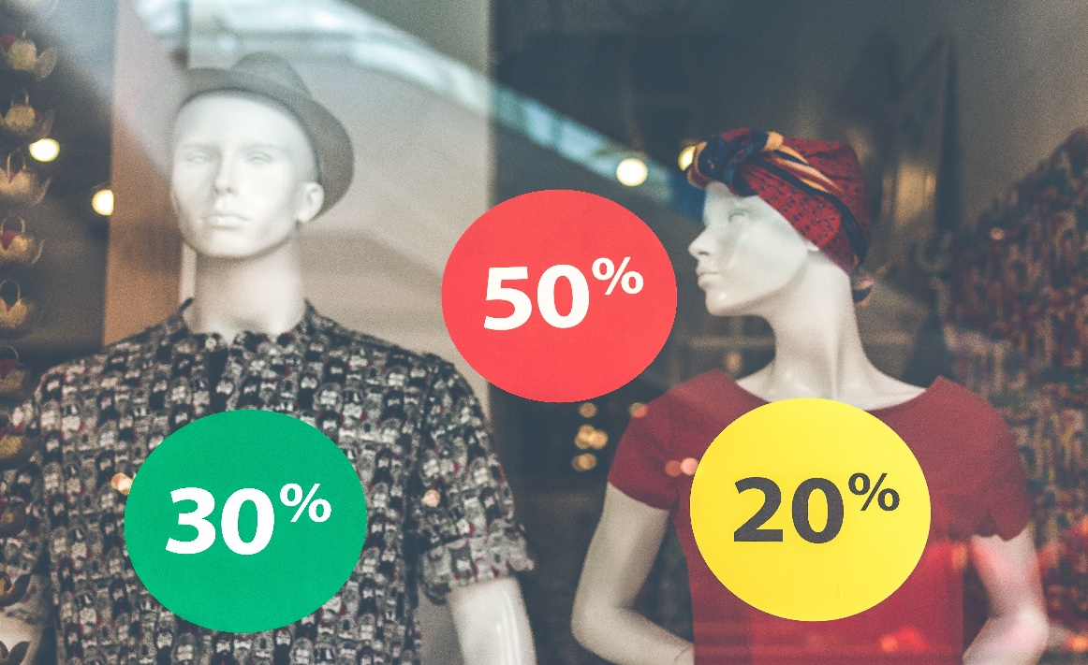
Vision
Comic One envisions itself to be an adaptive, trend setting merchandise store that is affordable and never compromises on its values of integrity, respect, and discipline.

Slide 4
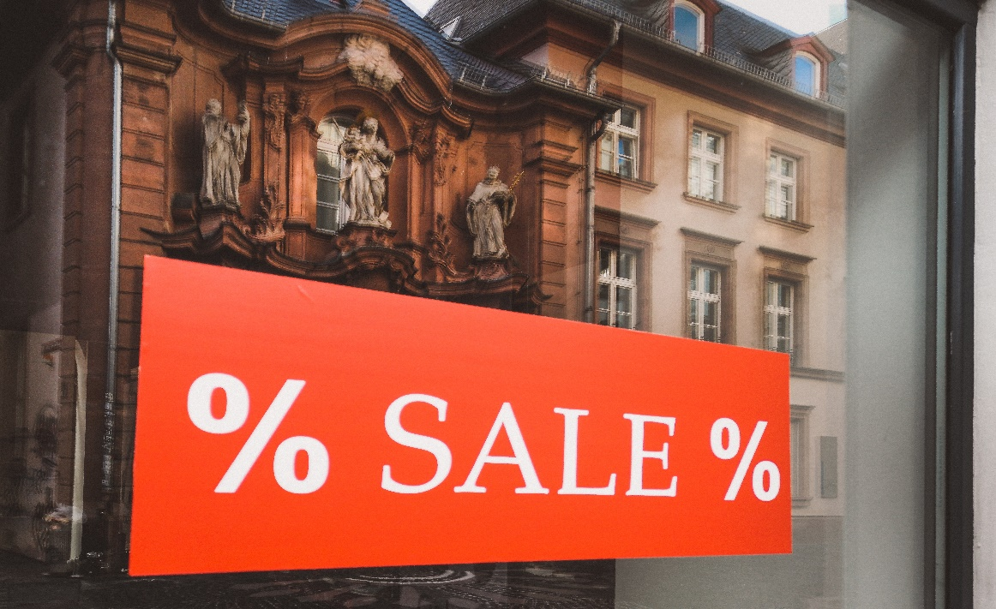
Mission
Our mission is to become a well renowned merchandise store in California and to establish 3 branches nationwide by the year 2030.

Slide 5

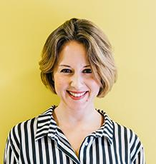
THE TEAM
Toby Black
Lexie Yu
Chief Executive Officer
Chief Marketing Officer
Manages and sustains the company’s overall development and growth, financially and technically.
Tasked with planning, implementing and controlling the marketing strategies for the company’s products

Slide 6
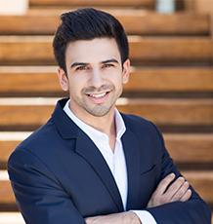

THE TEAM
Renz Johnson
Wendy Howardson
Social Media Marketing Manager
Quality Control Officer
Tasked with product and company advertising as well as marketing through the use of social media and the internet.
Manages and monitors the quality of products being sold in the market.
Ensures the production standards of the company are implemented.

Slide 7
The Problem
San Diego Comic-Con’s survey in 2016 shows that at least 10 merchandise stores within the San Diego area are forced to close on a nearly bimonthly basis due to
Low profits,
Bad reviews from clients due to poor customer service, and
Reasonable price points among others.

Slide 8

Our Solution
Comic One will provide a wide-range of toys for all comic collectors and anime lovers. Our well trained and accommodating staff will be in charge of ensuring that all clients are given proper customer service as well as ensure that all products are affordable, of great quality, and will last for a long time.

Slide 9
Advantages
Comic One will succeed as a merchandise store in California by :
Sourcing merchandise on both an international and local level.
Marking up all merchandise at very affordable rates.
Establishing paper based and online marketing strategies to reach out to a wider audience.
Online surveys and comment cards in order to better know what the clients desire.
Provision of a membership card that will provide exclusive access and discounts.

Slide 10

COMICxMANGA
“COMICxMANGA” is our newly launched program aimed to provide access to over 500 of the most popular and rare action figures and manga from around the world through a membership card. This membership will require a monthly fee of at $49.99.
$49.99
Monthly Fee

Slide 11
Traction
According to the Census Reporter, Los Angeles has a total population of 3.9 million permanent residents and up to 3 million yearly tourists last 2017. Roughly 60% of the residents and roughly 72% of the tourists were found to be interested in manga and comic books. Based on this census, Comic One will be able to gain a projected yearly traction of 1 million individuals on average.
Interested in Manga and Comic books
Residents
Tourists
60%
72%

Slide 12
Target Market
The chosen target market will be the residents of Los Angeles, California. This specific group of individuals was chosen based on the following factors :
At least 49% of the entire tourist population of Los Angeles visit the annual grand San Diego Comic-Con.
Up to 37% of the entire Los Angeles’ residents are fans and followers of comic books and anime characters.
At least 10, 000+ of the Los Angeles’ population are co-players, comic book writers, and manga artists among others.

Slide 13
Competition
As of 2018, Comic One concluded that the following companies are direct competitors on the basis that they offer similar products and services :
Central Town Merchandise offers a variety of merchandise starting at
$50
Japan Comic Town offers a variety of merchandise starting at
$49.99
New Generation offers a variety of merchandise starting at
$40

Slide 14
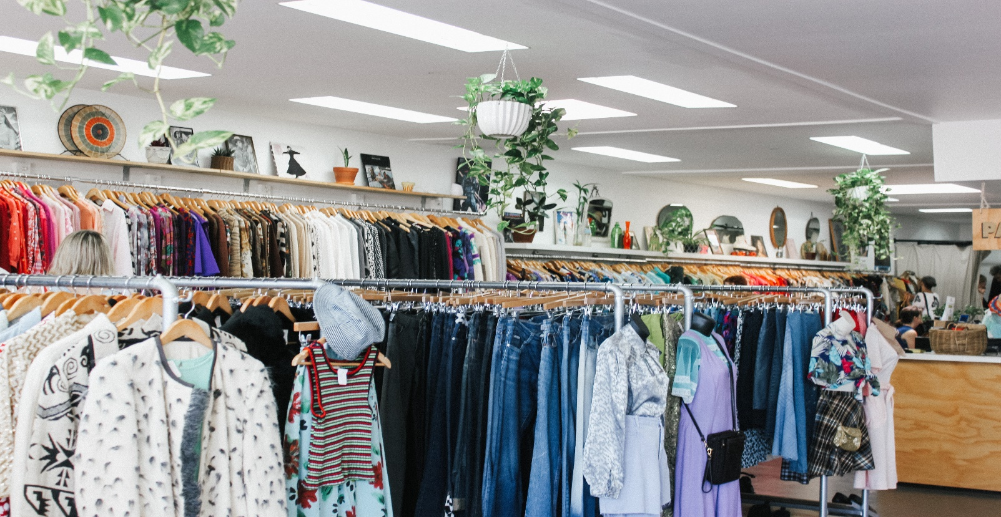
Alternative Solutions
Comic One will provide similar merchandise starting at just $29.99 in order to gain more customers with merchandise promos offered at competitive prices.

Slide 15


Business Model
The company will utilize the following business model which will be implemented by January to 2019 to April 2019:
[SPECIFY BUSINESS MODEL]
Revenue will be expected by April 2019.

Slide 16

Schedule
The company’s schedule will be as follows :
[SPECIFY COMPANY SCHEDULE]

Slide 17
Investment
In order to officially begin, the company will require a budget estimated between $90,000.00 and $100,000.00 and will be collected from the following sponsors :
OPX Merchandise
Black Comics Publishing Company
Bank Life Financial Insurance
This budget will be utilized as follows :
50%
Starting Capital
30%
Imported Products
20%
Employee Salaries
10%
Others

Slide 18

Contact Us
Visit our store every Monday to Saturday from 9am to 10pm and Sun 10am to 9pm at [ADDRESS].
Contact [NAME OF COMPANY] through any of these contact details :
[Phone Number]
[Email]
[Website]
[Social Media Account/S]

Slide 19
Thank You

