Slide 1
INLAY
ACADEMY OF MUSIC

Slide 2
Today’s Agenda
STRING MUSIC WORKSHOP
This promotional event will be held at Artist Activity Center on June 23, 2023 from 9 AM to 6 PM. A 1 day event aimed to promote a workshop for all string instrument enthusiasts.
PERCUSSION WORKSHOP
This 2-day event will be held at Center Mall Grounds on June 21, 2024 to June 22, 2024 from 9 AM to 6 PM. A 2 day event aimed to promote a workshop for all percussion instrument enthusiasts.
QUARTERLY STAFF MEETING
This quarterly staff meeting will be held at Inlay Academy of Music Conference Room from 12 PM to 6 PM on January 11, 2022 for the review of the developed and planned events handled by Inlay Academy of Music.

Slide 3
About
Inlay Academy of Music was founded in 1987 by Natalie Wightman who was a former pianist & opera singer. She started the music academy for all the people who wish to learn how to play any kinds of musical instrument. Inlay Academy of Music serves as a music school aimed to teach different types of genres for all the people who wish to learn different types of music. Today, Inlay Academy of Music is regarded as one of the best music schools across the country & is currently teaching 70 different musical instruments and genres.

Slide 4
Testimonials
“Come & join the biggest and strongest music school in the country.”
-Scott Victor, 26, Inlay Academy Orchestra Conductor

Slide 5
String Music Workshop
June 23, 2023 | 9am to 6pm
Artist Activity Center
All attendees will get up to 25% discount on enrollment fee & a free workshop kit. Projected profits gained from this event will be up to $150, 000 for the first 4 days which will be used for office renovation & equipment upgrade of Inlay Academy of Music.

Slide 6
Percussion Workshop
June 21-22, 2024 | 9am to 6pm
Center Mall Grounds
All profit accumulated from this event will be donated for the office renovation & system upgrade of “Music For Earth Foundation”.

Slide 7
Quarterly
Staff Meeting
January 11, 2022 | 12pm to 6pm
Inlay Academy of Music Conference Room
This meeting will update the status of the on-going plan for the planned workshops & will develop the extensive marketing strategy to be used for the planned events.

Slide 8
History
Founded by Natalie Wightman in 1987, Inlay Academy of Music has been regarded as one of the leading & top music schools in the country. It has long been producing famous & well-known musician in the mainstream & indie fields.

Slide 9
Testimonials from Clients
“From classical to modern, Inlay Academy of Music has never failed to amaze me with their teaching capabilities.”
-Peter Samson, 26, Guitarist

Slide 10
Main Goal
Inlay Academy of Music commits itself to teach music in the best possible approach in every type of genre available for all music enthusiasts.

Slide 11
Overview of Growth
50%
increase in annual profits as of November 2025.
60%
increase in teaching satisfaction as of March 2024.
80%
increase in students as of March 2025.

Slide 12
What We Offer
Variety of Musical Genres
Friendly & Effective Style of Teaching
Complete Musical Equipment & Instruments
Quality Assured Services

Slide 13
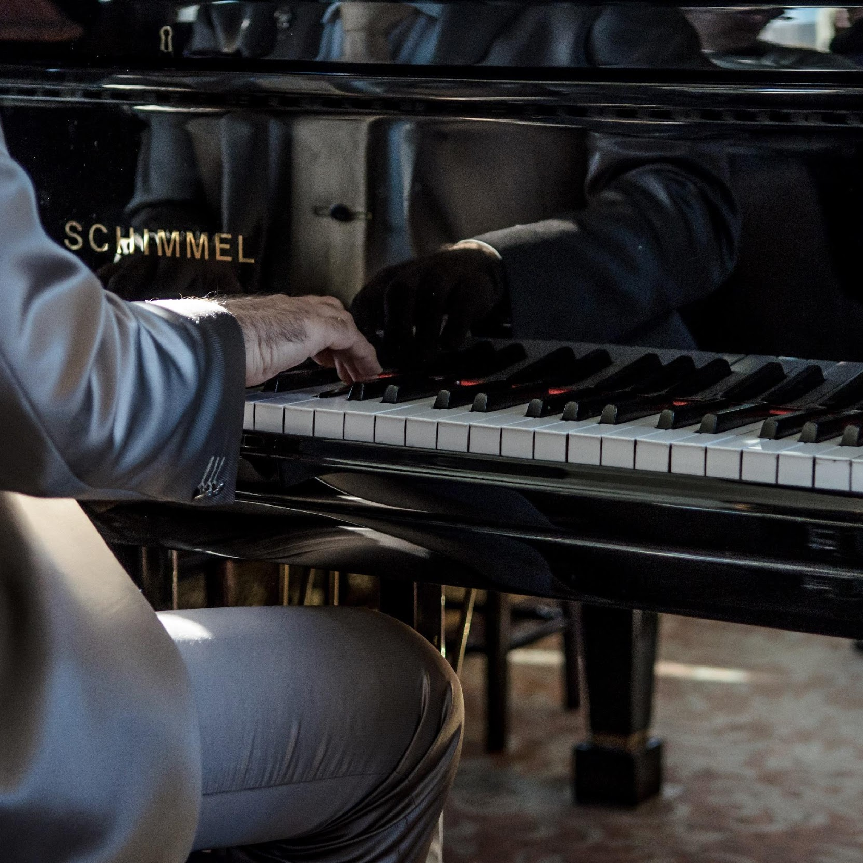
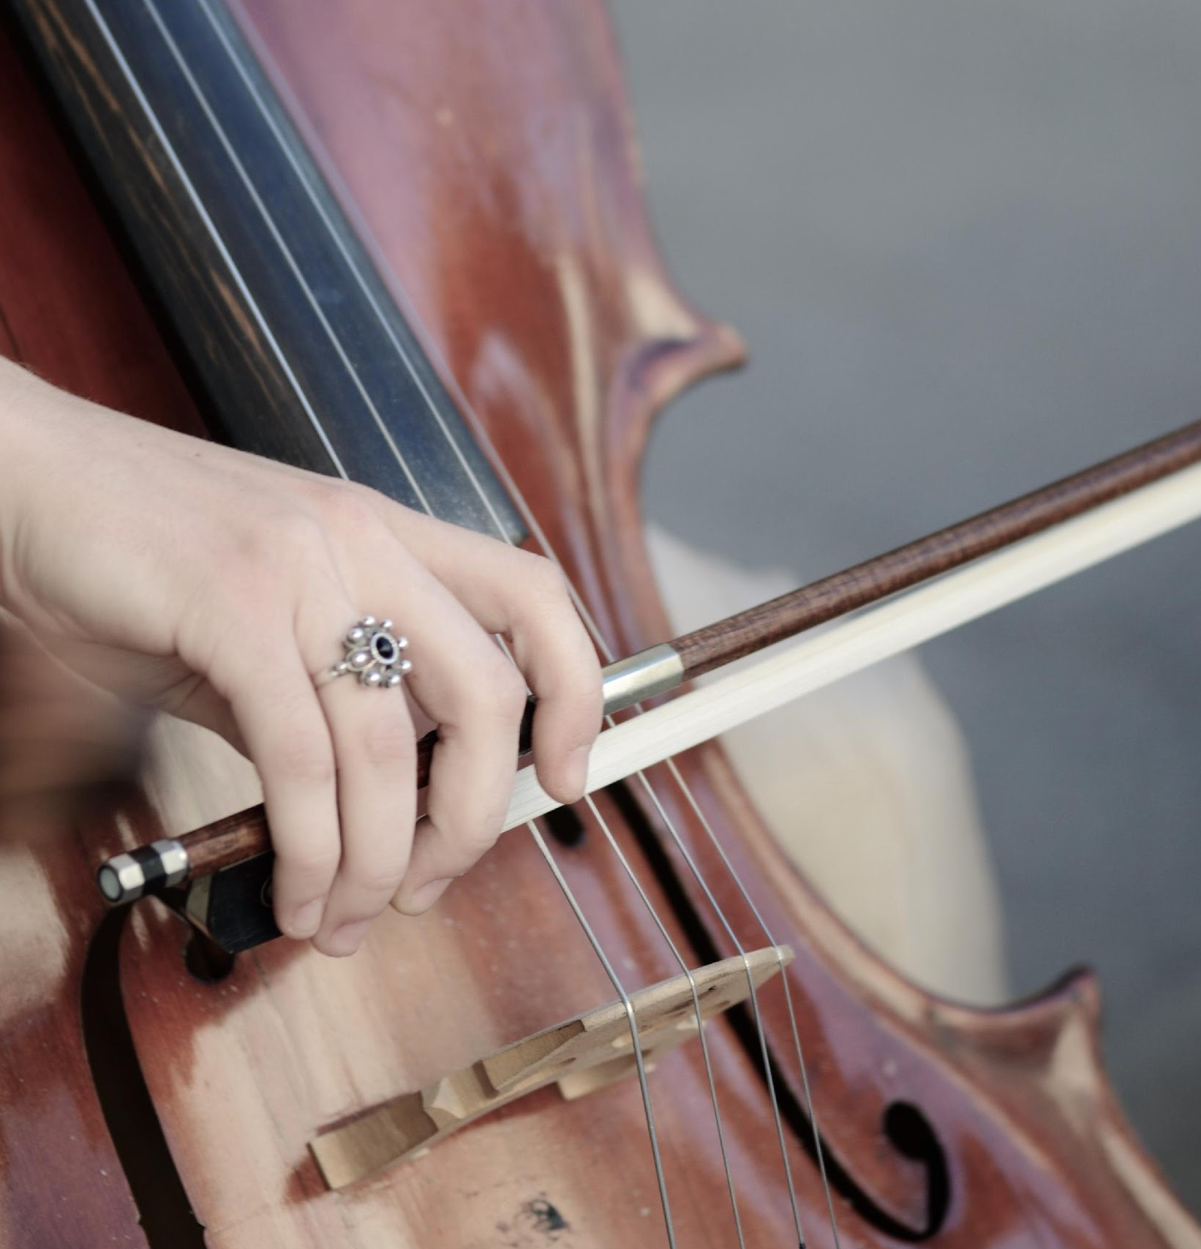
Gallery
@inlayacademyofmusic

Slide 14
Management
Natalie Wightman
Angela West
Henry Allen
Founder & CEO
Chief Operating Officer
Chief Marketing Officer

Slide 15
THANK YOU!
+383 3820203 | youremail@companyname.com

