Slide 1
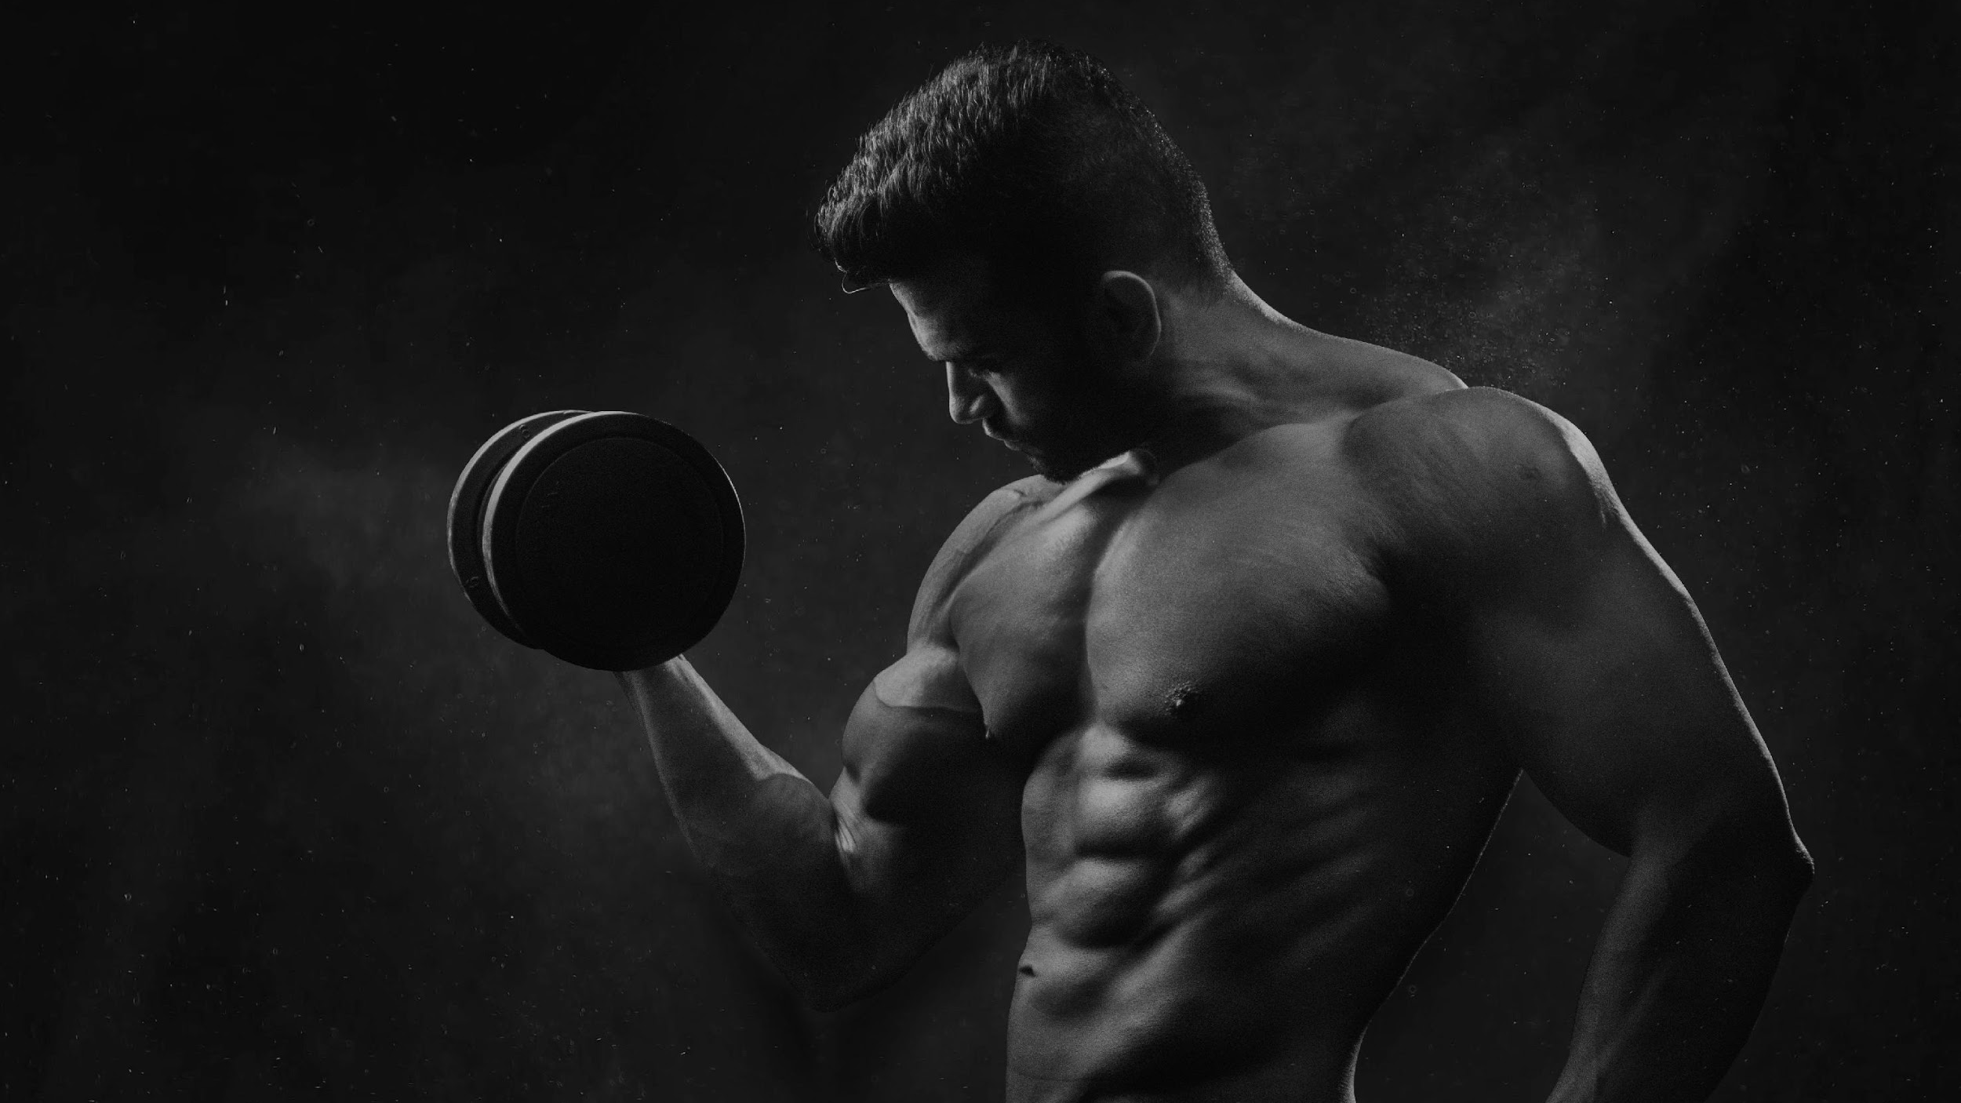
OBLIQUE FITNESS AND GYM
obliquefitness&gym.com
LOGO PRESENTATION TEMPLATE
94 Summit St. Davenport, IA 52807
Mon-Sat | +9082 09284
obliquefitness&gym.com

Slide 2
PRESENTATION
01
COMPANY LOGO REVIEW
02
COMPANY LOGO GENERAL PLEBISCITE
03
COMPANY LOGO GENERAL PROMOTION MEETING
This company logo review will be held at the Oblique Fitness and Gym CEO Meeting Room on November 17, 2022, from 12 PM to 6 PM. This meeting aims to review the current logo used by the Oblique Fitness & Gym promoted in the market.
This company logo general plebiscite will be held at the Oblique Fitness and Gym CEO Meeting Room on December 18, 2022, from 12 PM to 6 PM. This general plebiscite will present the 10 different logos that the gym utilized during its company logo review last November 17, 2022
This company logo general promotion meeting will be held at the Oblique Fitness and Gym on January 04, 2023, from 12 PM to 6 PM. This general meeting will discuss the general marketing strategy and promotion for the newly selected company brand and logo.

Slide 3
Eric Faultson
Founder & Chairman
As the founder and chairman of this gym, I am proud to present it to all fitness enthusiasts.
Oblique Fitness & Gym was created in order to give the best possible health regimens and fitness training programs in the gym industry. This gym embodies the meaning and essence of our mission and vision of being a highly reliable health and fitness provider through our extensive & meticulously developed training programs along with meal plans.

Slide 4
TESTIMONIALS
“
We are proud and excited to announce the new & improved Oblique Fitness & Gym; aimed to give you excellent training programs & fitness regimens for a stronger, healthier life.”
-Ann Benitez, 35, -
Chief Finance Officer

Slide 5
COMPANY LOGO REVIEW
Oblique Fitness and Gym CEO Meeting Room
November 17, 2022 | 12 PM - 6 PM
The review will be handled by the executives of the gym. The meeting will review the currently used logo promoted in the market and will present the new logo proposals the gym could use. The meeting will showcase 10 different brand logos so long as:
-the logo must exhibit the gym’s mission and vision
-the logo must be minimalistic yet attractive
-the logo must promote the gym’s motto
The company will also review the initial marketing plan to further generate & boost the company’s sales & customers in the market. Lastly, the logo that the gym will use for its operation will be marketed extensively & will be used in the official t-shirts, social media pages and online commercial & advertisements.

Slide 6
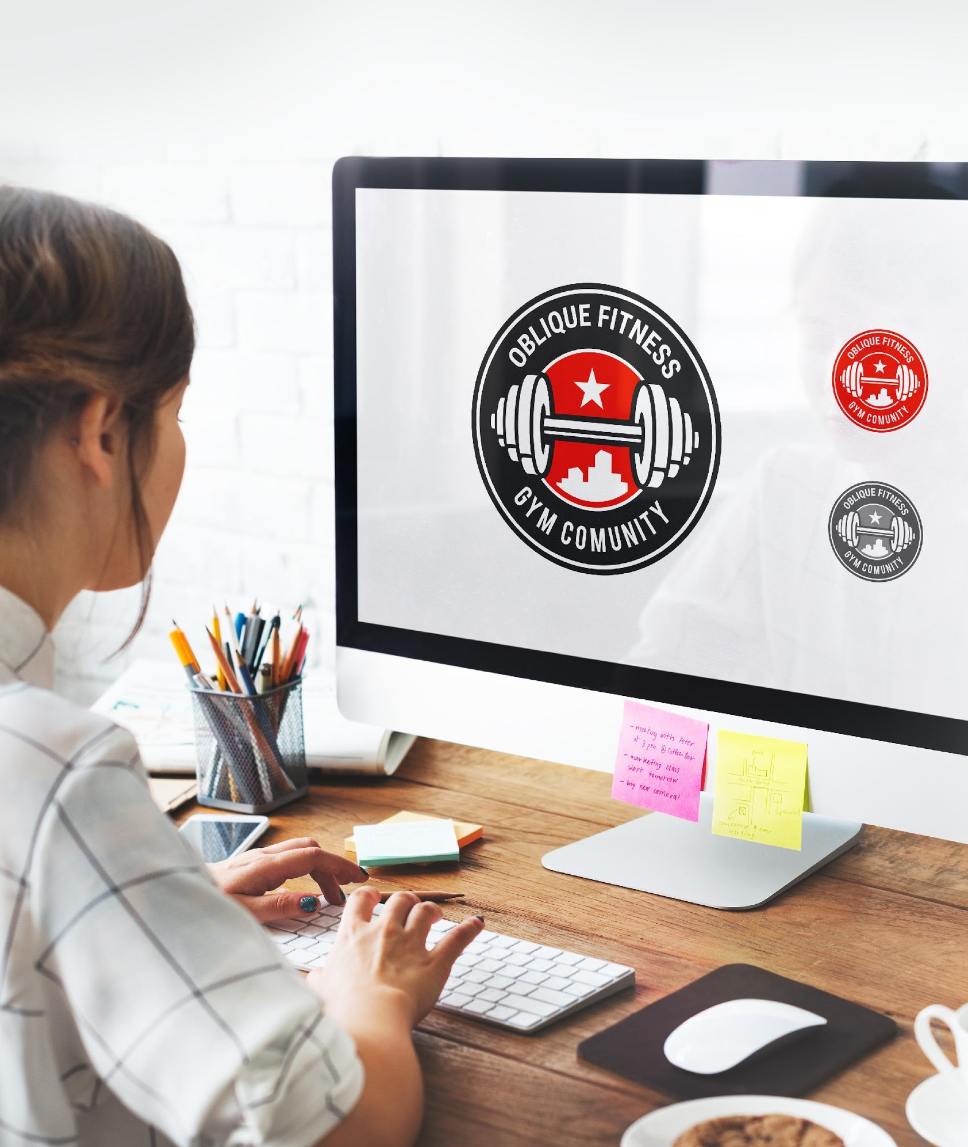
COMPANY LOGO GENERAL PLEBISCITE
Oblique Fitness and Gym CEO Meeting Room
December 18, 2022 | 12 PM - 6 PM
The program flow for this general plebiscite meeting will be as follow:
12:00 - 12:15 Prayer & Introduction
12:15 - 1:00 Initial Review of the Company’s Current Logo
1:00 - 4:00 Emblem, Logo & Company Brand Presentation
4:00 - 5:00 Voting & Review of New Logo
5:00 - 5:50 Company Announcements
5:50 - 6:00 Closing Prayer
The logo proposals will be presented by their respective creators & will be discussed to the executives of the company.

Slide 7
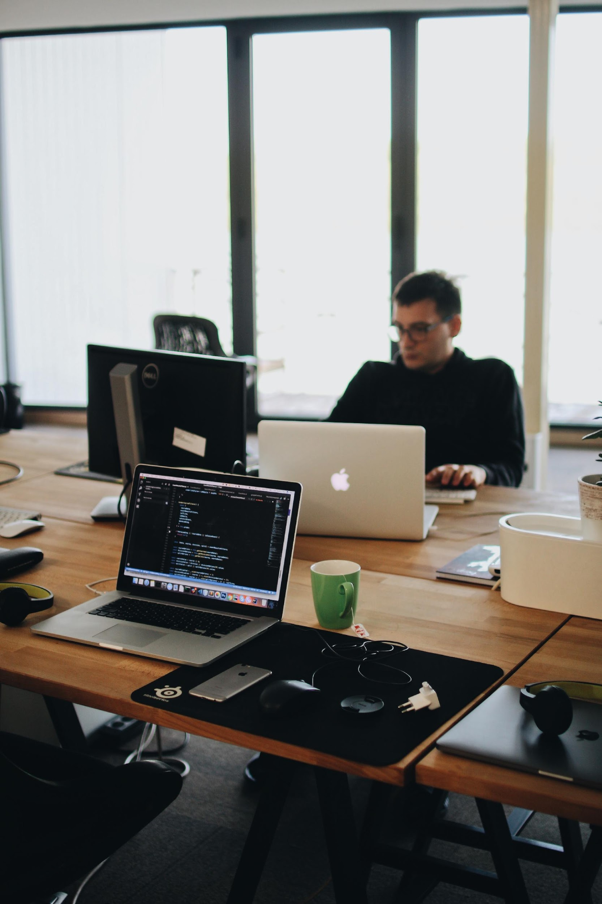
COMPANY LOGO GENERAL PROMOTION MEETING
Oblique Fitness and Gym CEO Meeting Room
January 04, 2023 | 12 PM - 6 PM
The executives will review the different options for the marketing strategy and promotion of the gym. The tentative plan for the marketing campaign will include the use of promotion of the company brand which includes the use and inclusion of the logo on the new official t-shirt gym, social media pages, and online commercial or advertisements.
The other tentative promotional campaigns for the brand will include:
-billboard advertisements
-national televised commercial advertisements
-banners and tarpaulins

Slide 8
ABOUT OUR COMPANY
Oblique Fitness and Gym was founded by Eric Faultson who is a registered doctor in medicine and physical therapist.
Today, the gym has 3 different branches across the country and up to 1, 000 active staff members with over 2, 000 active gym members. The gym is continuously developing its products and offered fitness regimens in the market for all who wish to experience Oblique Fitness.

Slide 9
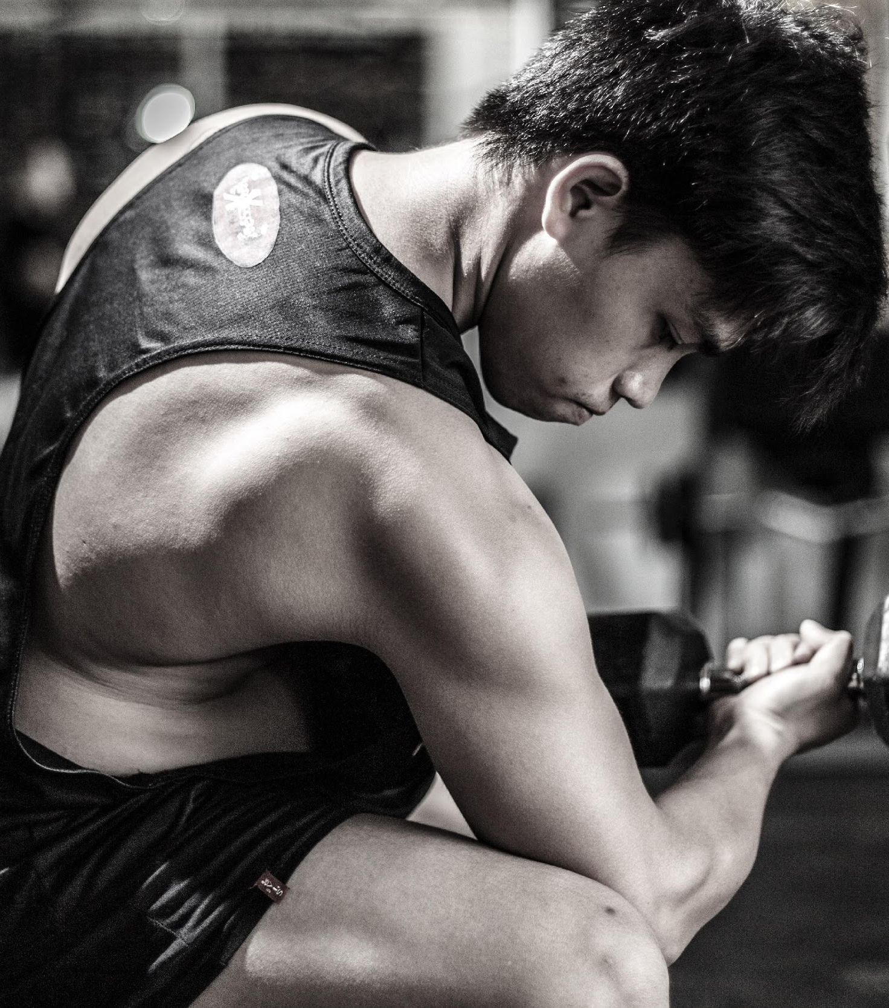
TESTIMONIALS FROM CLIENTS
“
I am always happy and satisfied with my fitness training at Oblique Fitness and Gym. They do their best to help me achieve well being through diet, exercise, & encouragement.”
- Joseph Claude, 19 -
Student & Bodybuilder

Slide 10
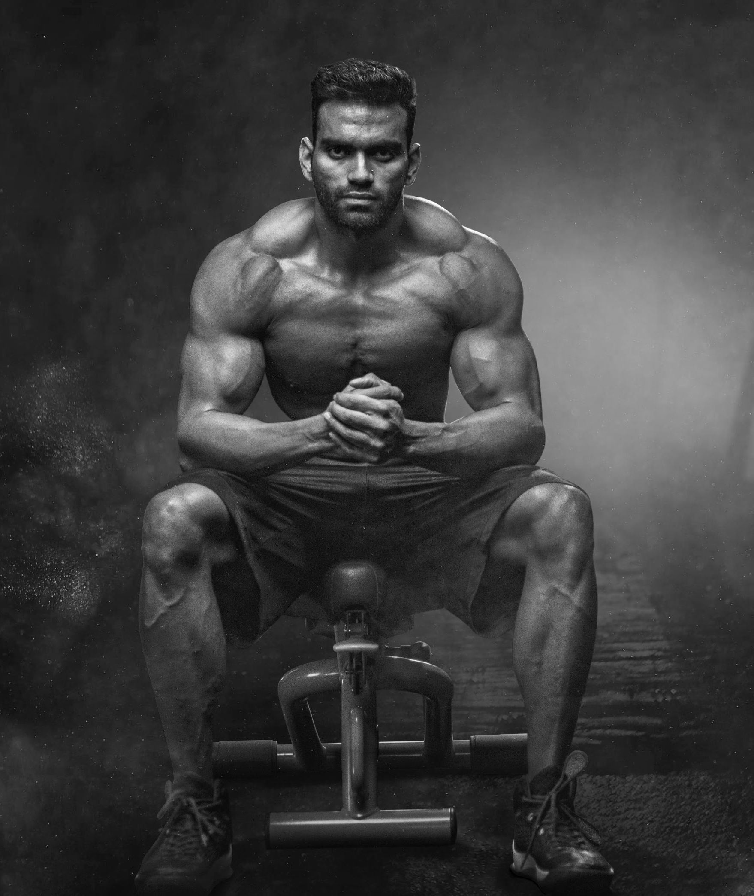
OUR MAIN GOAL
Oblique Fitness & Gym commits itself to give the best physical training and health regimens in the market.

Slide 11
OVERVIEW OF GROWTH
40%
50%
80%
increase in bi-monthly profits as of November 2022.
increase in client satisfaction as of March 2023.
increase in sponsor satisfaction as of March 2021.

Slide 12
OUR SERVICE
01
WORKOUT
04
CARDIO
a practice or exercise to test or improve one's fitness for athletic competition, ability, or performance.
one of the most important things you can do for your body, whether you want to lose weight, burn fat, or generally improve your health.
02
BODY BUILDING
05
EXERCISE
the developing of the body through exercise and diet
specifically : the developing of the physique for competitive exhibition
any bodily activity that enhances or maintains physical fitness and overall health and wellness.
03
NUTRIENT FOOD
06
BMR CALCULATOR
a food or ingredient that promotes growth, provides energy, and maintains life.
is also known as your body's metabolism; therefore, any increase to your metabolic weight, such as exercise, will increase your BMR.

Slide 13
WHAT WE OFFER
State of the Art and Complete Gym Equipment
Affordable Product and Service Packages
Various Fitness Regimens
Friendly and Accommodating Customer Service

Slide 14
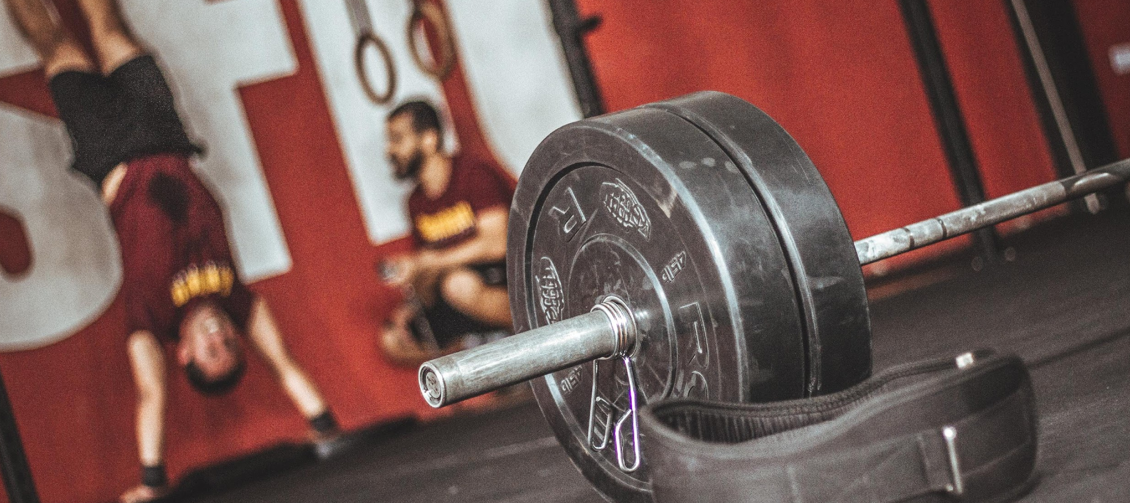
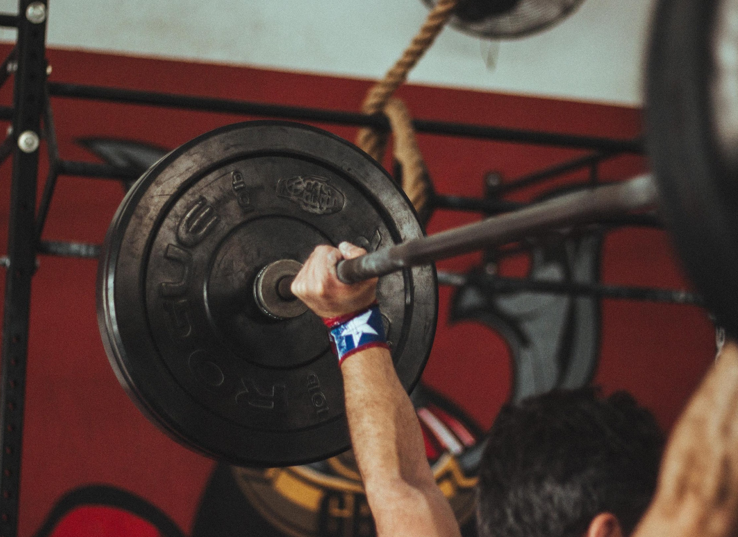
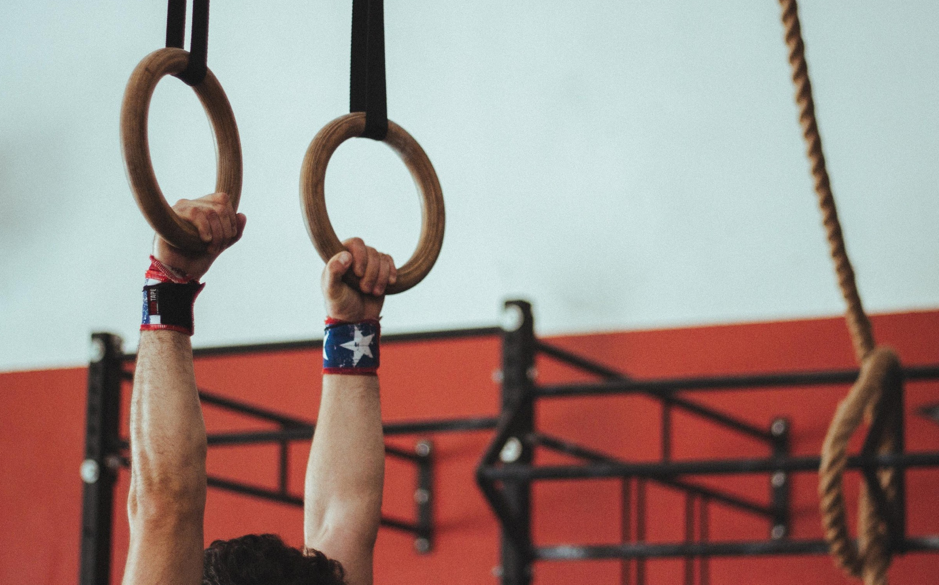
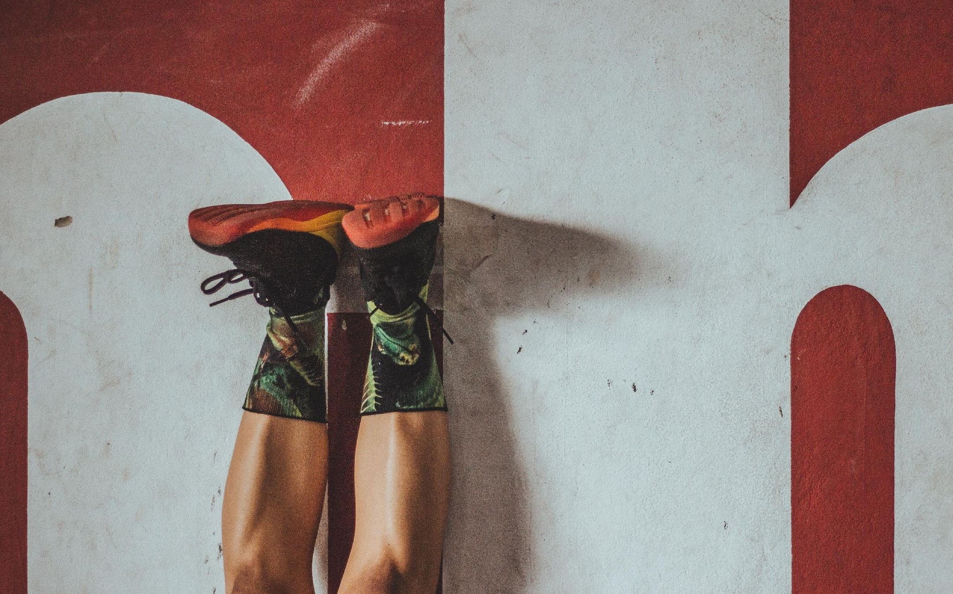
OUR GYM PLACE

Slide 15
OUR TRAINERS
Cris Luther
Jade Drake
Aynstine Tui
Jules Carson
Professional Trainer
Professional Trainer
Professional Trainer
Professional Trainer
@crisluther
@jadedrake
@aynstinetui
@julescarson

Slide 16
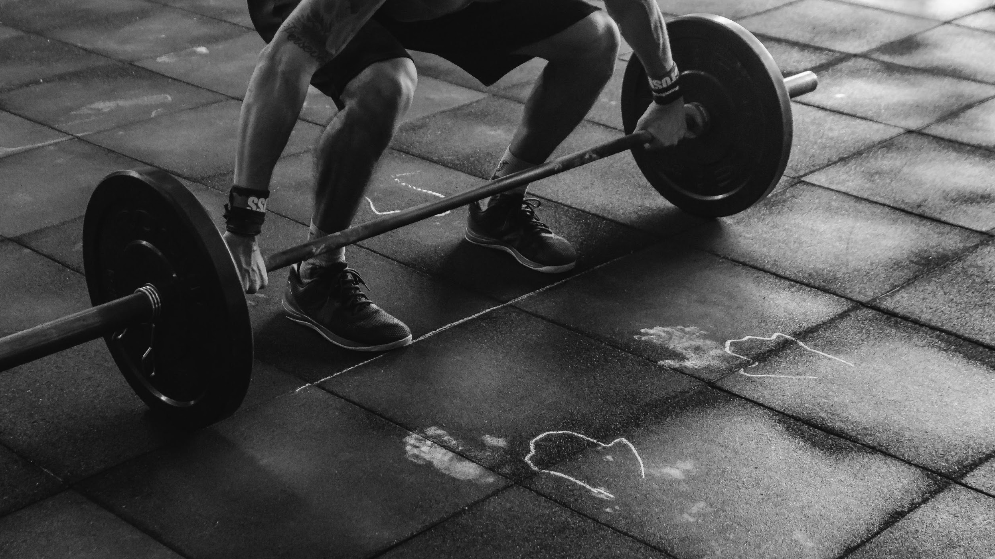
START YOUR PERSONAL TRAINING SESSION

Slide 17
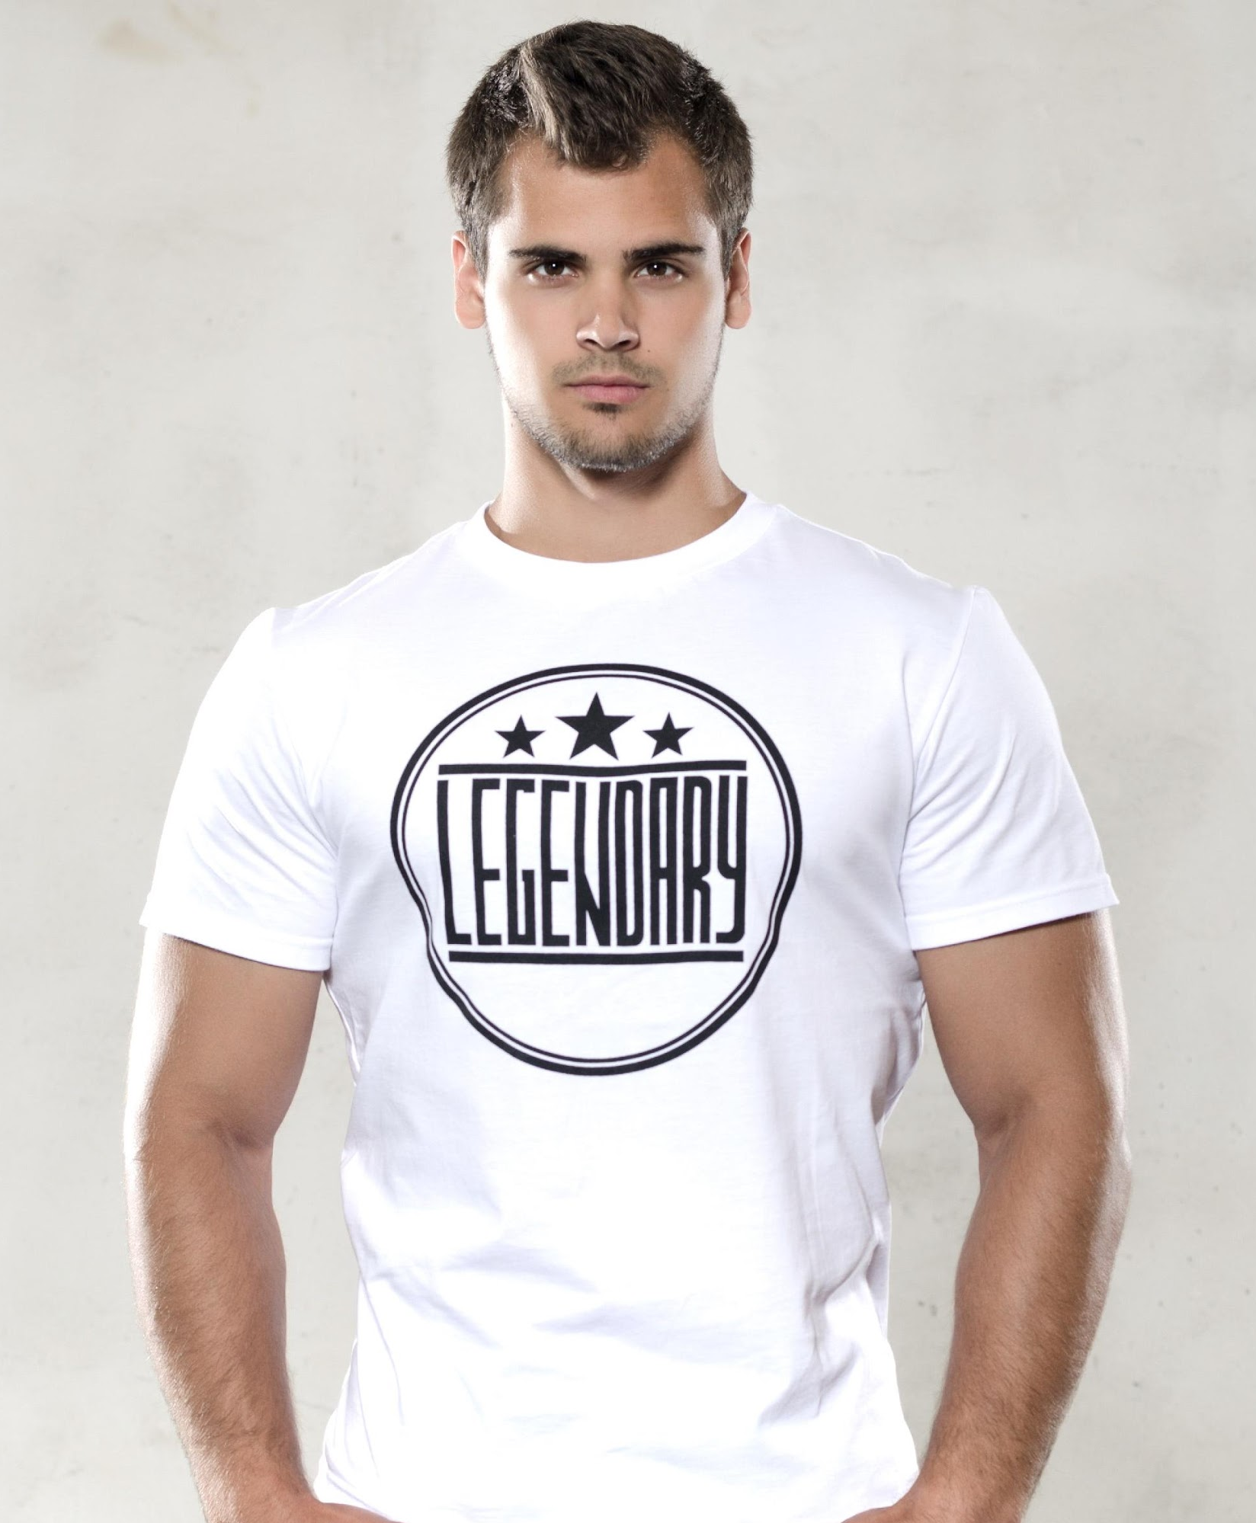
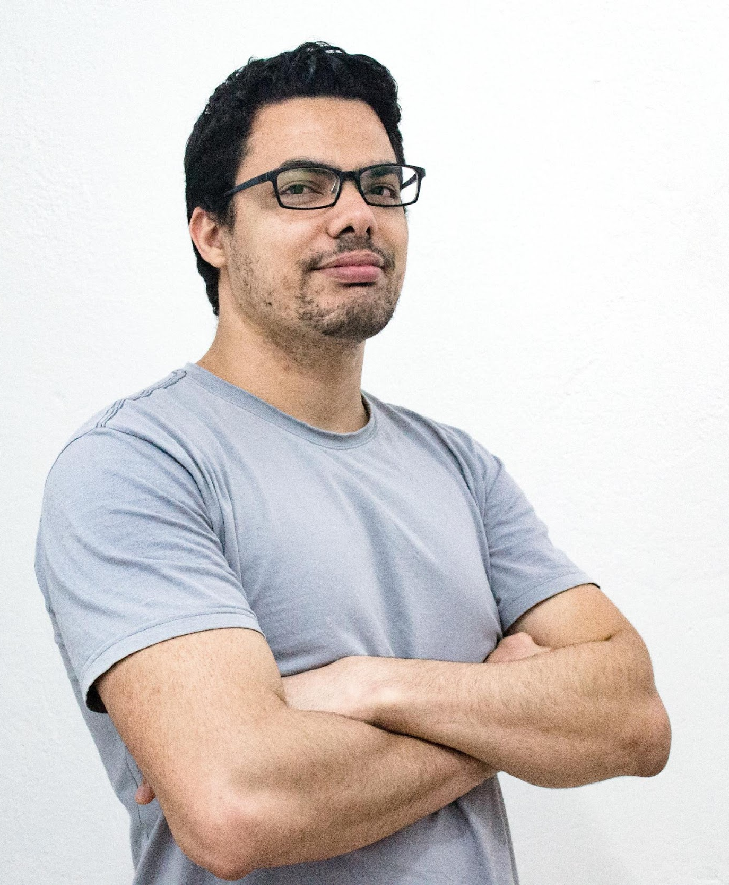
OUR TEAM
Eric Faultson
Terry Carrols
Lowry Benitez
Founder & Chairman
Chief Marketing Officer
Chief Finance Officer

Slide 18
THANK YOU
obliquefitness&gym.com

