Slide 1
ESCAPADE
FOOD TRUCK PITCHDECK
escapade@foodtruck.com
918-920-5001
www.escapade.com

Slide 2
The Restaurant
Executive Summary
Escapade food truck aims to give its clients the freshest & most delicious seafood cuisine from all over around the world.
escapade@foodtruck.com

Slide 3
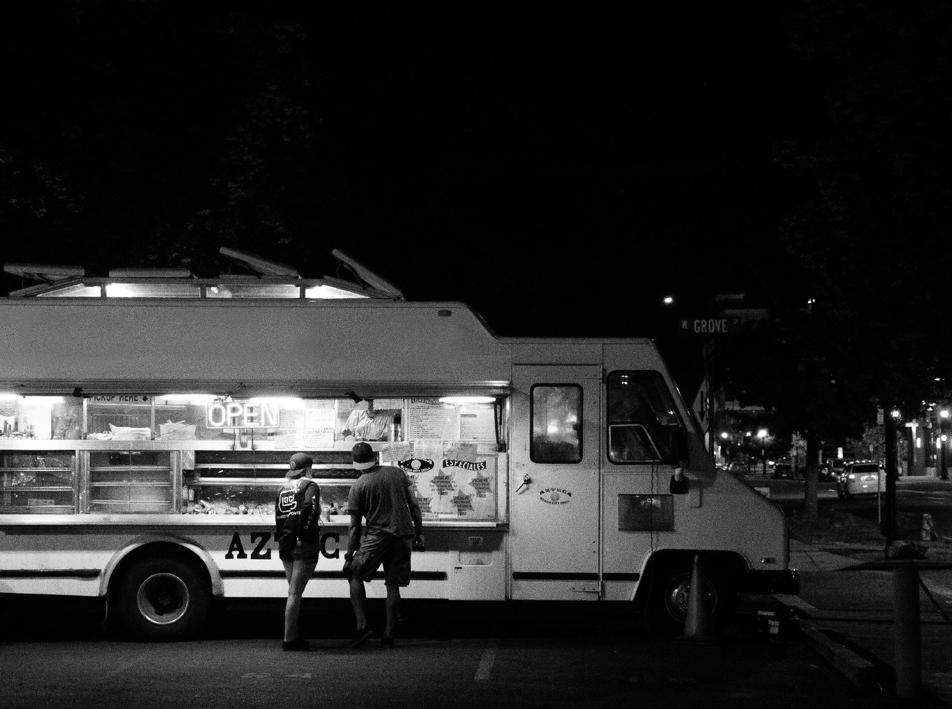
The Restaurant
Escapade is a seafood food truck restaurant based in Queens, New York. It has been in the industry since 2013 & was opened by Alahmar al-Naderi who was an executive chef in Jeddah, Saudi Arabia.

Slide 4
The Restaurant
Vision
To be able to provide excellent quality seafood dishes while lessening the overall food waste production.
escapade@foodtruck.com

Slide 5
The Restaurant
Mission
A. Establish 10 branches across the country,
B. To acquire at least 3 Michelin stars, and
C. To become a well-renowned seafood food truck restaurant in 2030.
escapade@foodtruck.com

Slide 6
The Restaurant
Philosophy
We incorporate our food operation with the qualities of integrity, minimalism & elegance that transforms our food’s taste into something unique.
escapade@foodtruck.com

Slide 7
The Restaurant
escapade@foodtruck.com
Outlook
Food service has been one of the most competitive businesses in the industry that attracts millions of people the whole year. This is a worthwhile business to invest in the area because:
• Survey says in 2016 that only 3 out of 500 restaurants in Queens have Michelin star.
• Clients seeking competent & synergy staff.
• Up to 50 restaurants are closing down on a yearly basis
• Clients seek restaurants that retain quality standards.

Slide 8
The Restaurant
Organizational Structure
Type of Industry:
Business Structure:
Ownership:
Food Truck Service, Restaurant
Sole Proprietorship
Sole Proprietorship, Alahmar Al-Naderi
escapade@foodtruck.com

Slide 9
The Restaurant
Owner & Chairman:
Executive Chef:
Sous Chef:
◦ The highest ranking officer.
◦ Has influence over the direction of the company.
◦ Menu creation, staff management, kitchen control, plating design & cost control.
◦ Assistant of the executive chef.
◦ Assigns schedules.
◦ Executive chef substitute.
◦ Controls order & cleanliness
escapade@foodtruck.com

Slide 10
The Restaurant
Management
Team
Management Team | Role/Function | Skills
Matt Fry | Executive Chef | Leadership Skills, Organizational Management Skill, Creative, Communication, Work Ethic
Travis Boyle | Sous Chef | 25 Years of Experience, Teamwork, Leadership, Performance Management, Well-Organized
escapade@foodtruck.com

Slide 11
Offers & Services
escapade@foodtruck.com
Description
Incorporating the taste of Mediterranean & Western Seafood Cuisine, Escapade Food Truck will introduce the ff. new cuisines:
• Maple Tuna Belly
• Salmon Cake
• Mussels Mariniere
• Oysters Rockefeller
• Broiled Tilapia Parmesan

Slide 12
Offers & Services
Marketing Plan
Our marketing strategy emphasizes the combination of traditional & millennial styles of promoting.
• Televised Commercials
• Social Media Advertisements
• Printed Flyers & Posters
escapade@foodtruck.com

Slide 13
Offers & Services
Market Research
As the information dissemination evolves, adapting to new ways of promoting events became a substantial challenge for companies.
• With the emergence of social media & internet, online advertisement has become prevalent.
escapade@foodtruck.com

Slide 14
Execution
escapade@foodtruck.com
Marketing Strategy
• Focuses on target audience through social media & printed flyers.
• Advertising tasty special cuisines for clients who are interested to enjoy new kind of cuisine.
• Effectively engaging with potential clients.

Slide 15
Execution
Marketing Strategy
Marketing Strategy | Activities | Timeline | Success Criteria
Promotion Videos | - The marketing team will create testimonials & promotional videos | December 2022 | The new content is up on the company website & various social media accounts.
Regular Content Updates | - The marketing team will create a posting schedule | February 2023 | Steady growth of traffic & followers for the company website & social media accounts.
Cold Emails | - Write templates for the emails to be sent out to potential clients | May 2023 | The cold emails are ready to be sent.
escapade@foodtruck.com

Slide 16
Operational Plan
escapade@foodtruck.com
Software | Quantity
Edition Software | 1
Skype & Yahoo | 1
Hardware | Quantity
Desktop | 5
Laptops | 5

Slide 17
Operational Plan
Marketing Infrastructure
Infrastructure | Existing Y/N | Description
Social Media | Y | The company has Twitter & Instagram accounts.
Website | N | Website is still in development.
Network speed | Y | Network is working properly & causes no delay in company operations.
Data Storage | N | Company data storage as of now is still limited.
escapade@foodtruck.com

Slide 18
Start-Up Summary
Total Funding
Required
Start-Up Funding
Start-Up Expenses | $50,000
Start-Up Assets | $50,000
Total Funding Required | $100,000
escapade@foodtruck.com

Slide 19
Start-Up Summary
Total Assets
Non-Cash Assets from Start-Up | $20,000
Cash Requirements from Start-up | $20,000
Additional Cash Raised | $2,000
Cash Balance on Starting Date | $2,000
Total Assets | $100,000
escapade@foodtruck.com

Slide 20
Testimonials
I’ve been a food vlogger for almost 8 years & I must say that Escapade has unique flavors & tastes that you’ll certainly enjoy. The amount of Western & Mediterranean flavor is just perfect!
Travis Mills, 31, Food Vlogger
Traveled all along from Michigan to New York just to taste this restaurant’s cooking. Absolutely the best!
Rose Silverman, 25, Tourist
escapade@foodtruck.com

Slide 21
Thank You!
escapade@foodtruck.com
918-920-5001
www.escapade.com

