Slide 1
Lunar
Films Inc.
Dreams of Tomorrow
^{A Film Proposal}
^{by Lunar Films Inc.}
_{lunarfilmsinc.com}
October 19, 2026

Slide 2
Categories
Storyline
Synopsis
Project Timeline
Actors
Testimonials

Slide 3
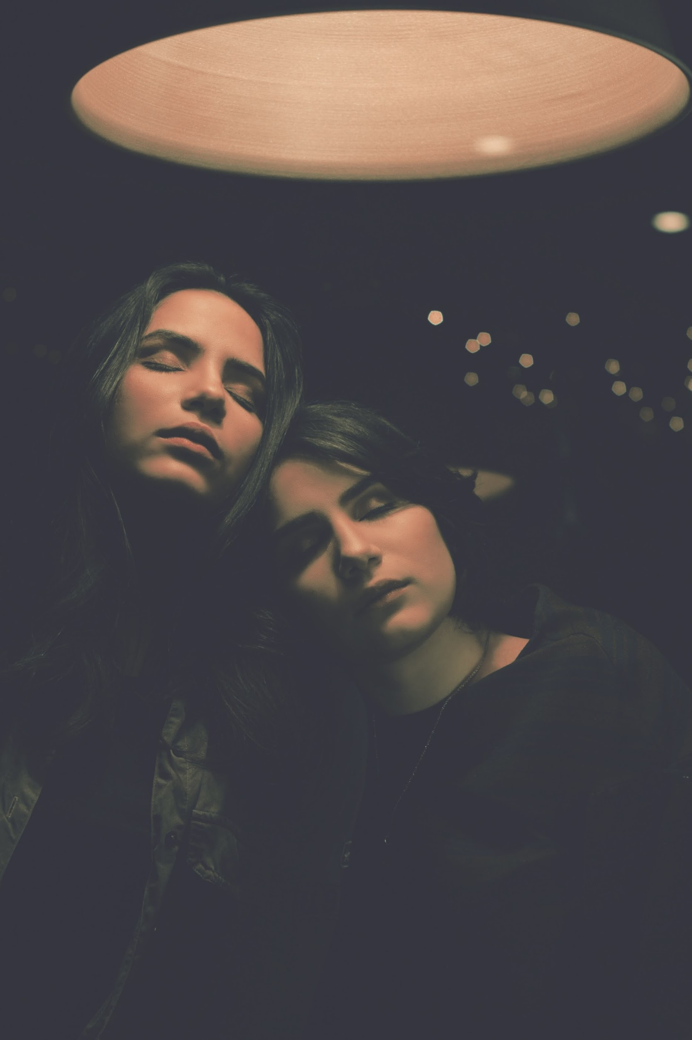
Dreams of Tomorrow
Synopsis
Megan is an overachiever from Bristol who dreams of making it in the field of medicine. Freddy, a teenager from Birmingham just got expelled from school & is looking to make a name for himself in the music industry. Jane, on the other hand, is just coursing through college & doesn’t exactly know where she is headed & what to do with life. 3 characters with different backgrounds, different goals & different stories. But after a tragic incident in London happens, these characters are faced with the fact that they aren’t so different after all.
Story line
Lunar Films Inc.

Slide 4
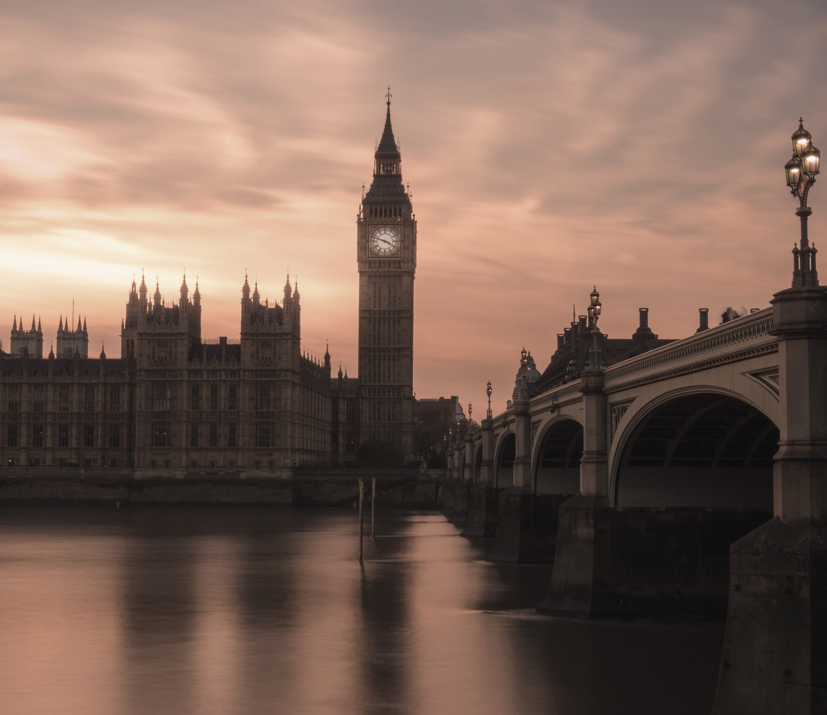
Theme
No matter how small your dreams are, when you strive hard, you’ll reach the stars.
Tone
Melodramatic essence of the show “Skins” with the cinematography of “Moonlight”.
Logline
Megan, Freddie & Jane battle with personal & geographical dilemmas that can hinder or mold their dreams of success yet find solace in the existence of each other.
Lunar Films Inc.

Slide 5
The Company
Styling & Inspiration from other Films
^{Skins}
^{Breaking Bad}
^{Moonlight}
^{Slumdog Millionaire}
^{The Fault In Our Stars}
^{The Butterfly Effect}
Lunar Films Inc.

Slide 6
Project Timeline
Pre-Production (3 Months)
Procuring rentals for equipment & materials.
Press release & preparation of media contact list.
Hiring & finalization of cast & crew.
Guaranteeing access to filming locations.
Lunar Films Inc.

Slide 7
Project Timeline
Pre-Production (6 Weeks)
Addition of effects (sound effects, music, final sound mix, color correction, etc.
Gain sponsorships & advertisers.
Launch of online marketing campaigns.
Announcement of the cast to build hype.
Shooting of film.
Editing of film to rough cuts. Finalization of show through different departments.
Lunar Films Inc.

Slide 8
Project Timeline
Original Soundtrack
5 original songs will be sung individually by the main actors of the film.
Lunar Films Inc.

Slide 9
Project Timeline
Cast
Lunar Films Inc.

Slide 10
William Durant (Freddy)
William Durant (Freddy) - is a Silver World nominee for his work in the show, “The Great Dog”, William has been in national commercials & short skits around Manchester’s theatre community.
Maureen Giltner (Megan)
Maureen Giltner (Megan) - Gainer rise to fame from her performance in the off-broadway show, “Imagination”. She has been a performer all her life, starting off with school plays, community centers & eventually studied university with a major in acting.

Slide 11
Shelia Ingersoll (Jane)
Shelia Ingersoll (Jane)- Though this is her first feature film, Sheila has gained high praises from director, Dewey Hewitt, for being such a believable actress. She has also had her fair share of experience in the theatre world back in her hometown of Columbus, Ohio.
Jeffrey McGruder (Ryan)
Jeffrey McGruder (Ryan) - Was crowned Best Director for The Young Thespians Academe Film Fest for his work on a short film called, “Skippy”, Dream of Tomorrow is Jeff’s first full-length feature film to direct. His experience mostly focused on directing shorts & artistic music videos that you may be familiar with.

Slide 12
Project Timeline
28 %
Growth Overview
45 %
74.6 %
33.5 %
There is an increase in annual profits as of April 2022. There is an increase in Social Media interaction & satisfaction with as of June 2024. Also there is increase in awareness in the market as of March 2023.
Posters
Focuses on target audience through social media & printed flyers. Advertising the upcoming films to people who are interested in Movies. Effectively engaging with potential clients.
Magazine
Cards
Tickets
Lunar Films Inc.

Slide 13
Company Milestones
The team in this department also manages client concerns & collaborates.
Short-term Goals | Milestones
Social media brand marketing | Reached 50% of audience target.
Company Building Expansion | Film Making started 2024
Long-term Goals | Milestones
Partnership with Axon Films | Contract signing on February 2027
Brand expansion in New York & New Jersey | Budget proposal drafted as of July 2026

Slide 14
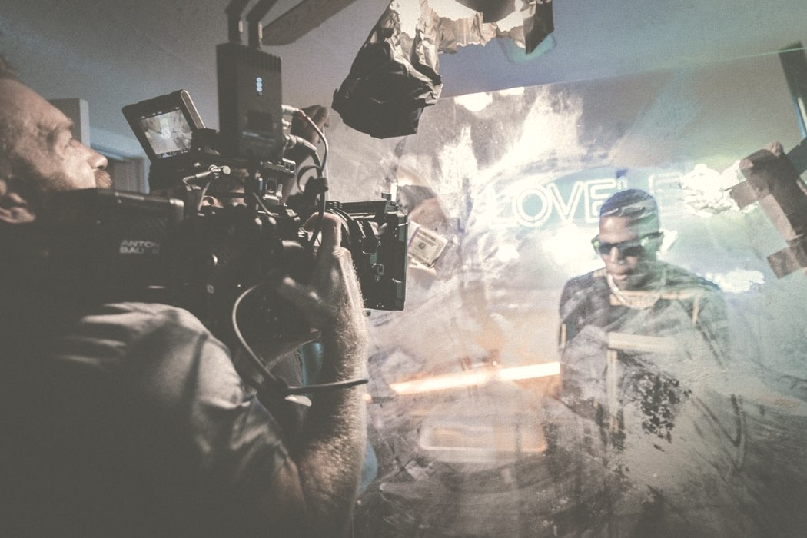
Outlook
Film Making has been a major hit in today’s industry. Clients seek to have a budget-friendly, memorable Films. Dreams of Tomorrow has easily been one of the most heartwarming films to watch this year. It has been smartly written with acting that is equally as great.

Slide 15
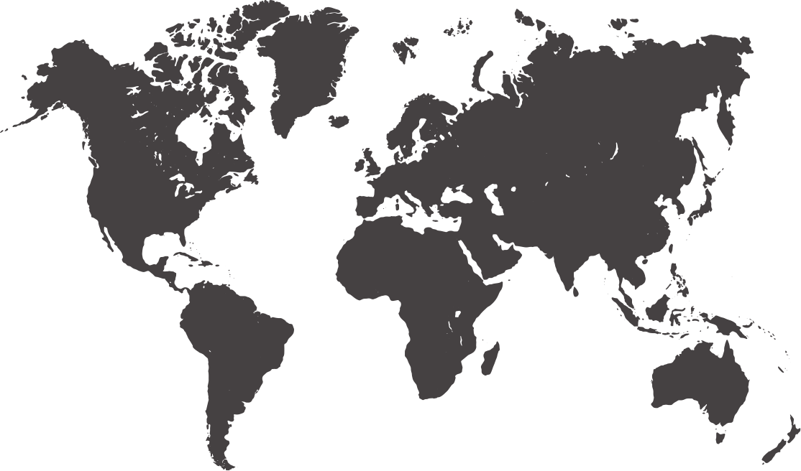
Project Timeline
Screening
Areas
^{Canada}
^{United Kingdom}
^{USA}
^{Spain}
^{South Korea}
^{Mexico}
^{Philippines}
Lunar Films Inc.

Slide 16
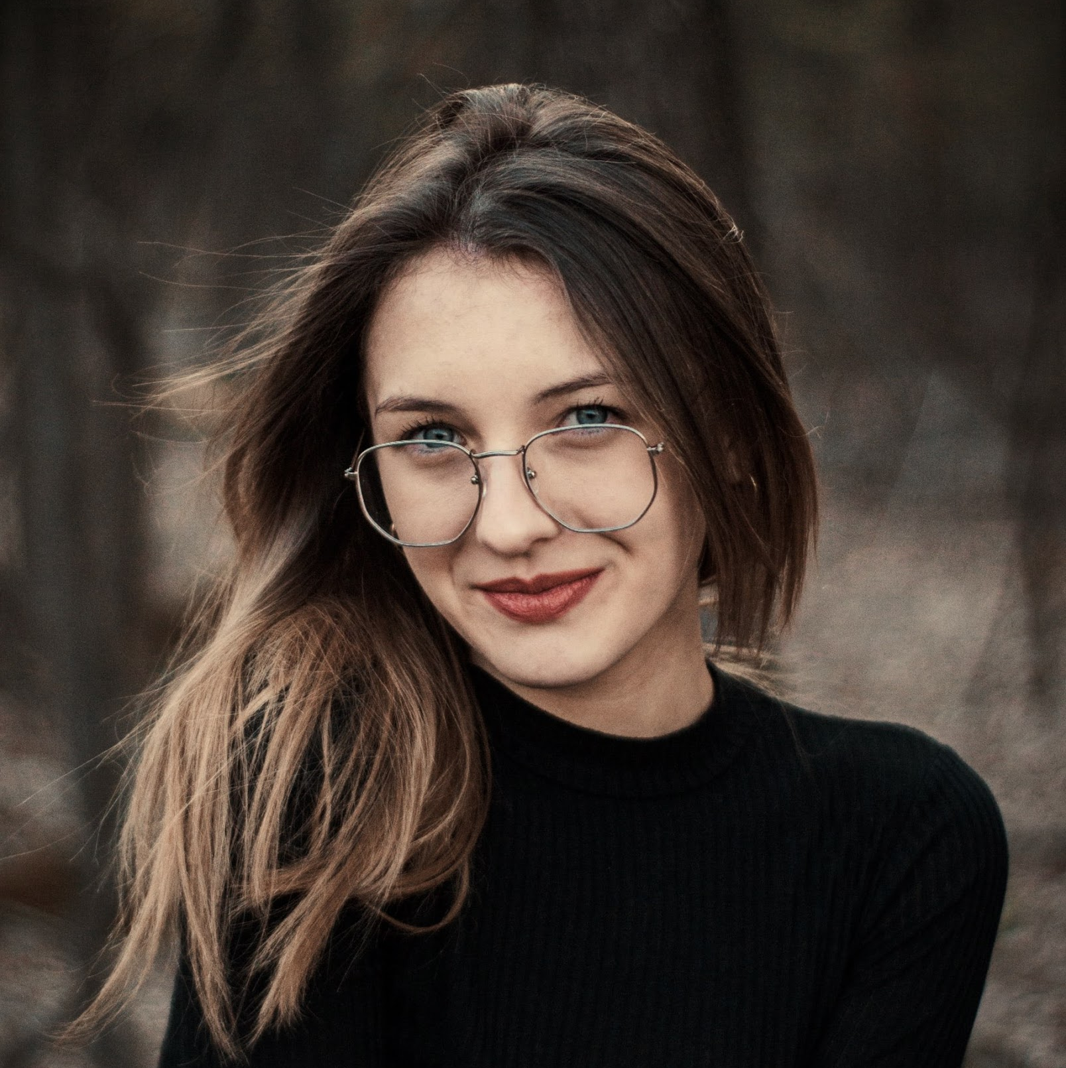
Testimonials
“Me along with half of my family is under the employment of Master Events Production. The company has had a big impact on my life. Master Events Production has worked hard to keep our clients satisfied with our work. Our continued business today just goes to show it.”
^{- ; J. Wyans, 32, Engineer}
Lunar Films Inc.

Slide 17
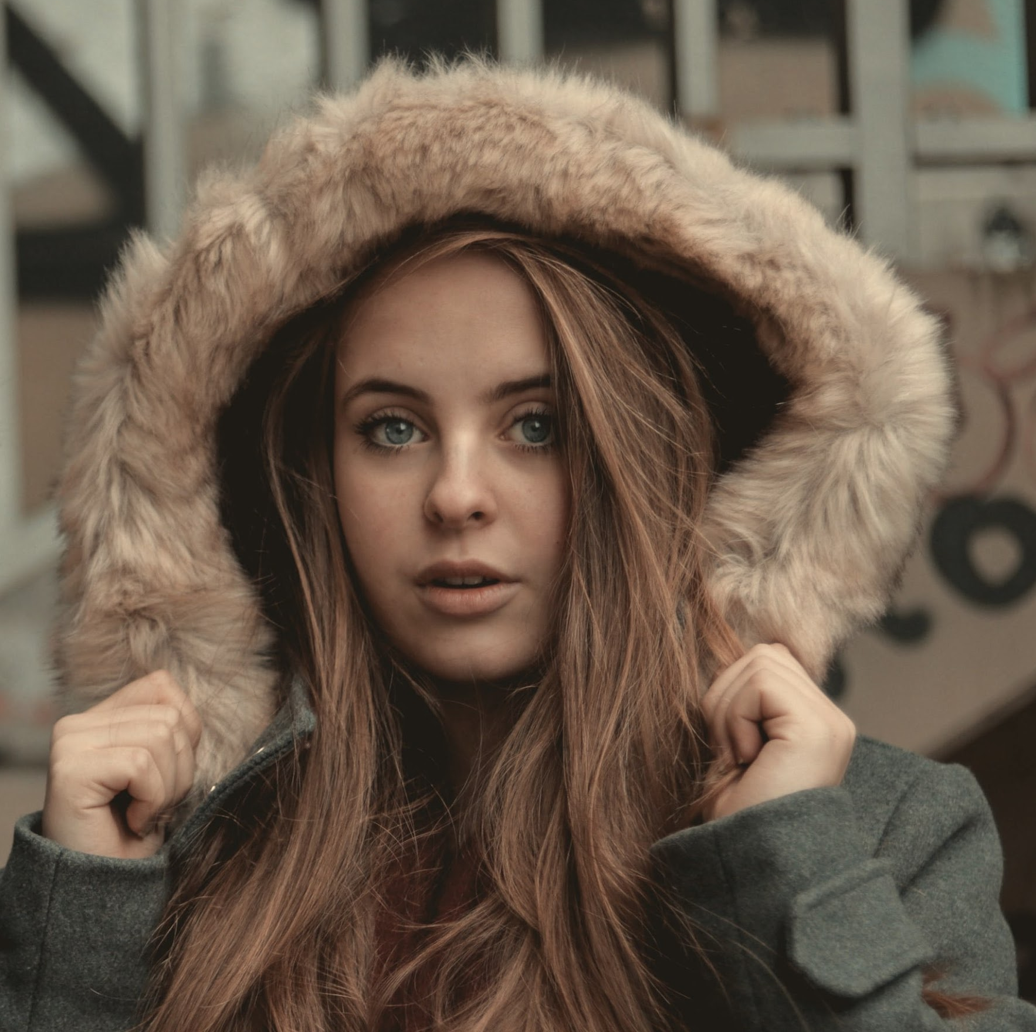
Testimonials
“Me along with half of my family is under the employment of Master Events Production. The company has had a big impact on my life. Master Events Production has worked hard to keep our clients satisfied with our work. Our continued business today just goes to show it.”
^{- ; J. Wyans, 32, Engineer}
Lunar Films Inc.

Slide 18
Thank you
²¹⁶⁻³⁵⁵⁻³⁰¹⁶
1981 Little St., Homer, OH, 44235, USA

