Slide 1
Client
Pitch Deck

Slide 2
About Us
DZelectronix is a technology and electronic based company store located in Los Angeles, California. It was founded by Eric Hue and has been operating since 2003.

Slide 3
Vision
DZelectronix’s vision is to become the leading technology company store in the country by the year 2030 and establish 5 different branches nationwide.
Mission
Our mission is to provide quality technology and electronics at reasonable prices.

Slide 4
The Team
Tim Smart
Lawrence Tan
Chief Operating Officer
Chief Quality Officer
Manages general company operations on a daily basis.
Maximizes the share prices, market shares and revenues of the company.
Monitors the consistency of company standards applicable to all products produced and sold.

Slide 5
The Team
Peter Lane
Winston Fryer
Quality Control Officer
Quality Control Officer
Manages and monitors the quality of products being sold in the market.
Ensures the production standards of the company are in place at all times.
Manages and monitors the quality of products being sold in the market.
Ensures the production standards of the company are in place at all times.

Slide 6
The Problem
Tesla Magazine’s conducted survey in 2015 shows that 13 companies in the electronic industry were closed by the administration due to low quality products sold in the market at unreasonably high price points.

Slide 7
Our Solution
DZelectronix provides quality assured products that have been tested and approved by the company to deliver maximum performance and last for a long time. These products will be made available at prices comparatively lower than other companies in the market.

Slide 8
Advantages
The latest, top performing technology and electronics from both local and international brands at competitive price ranges.
Monthly offers and discounts for those with exclusive membership cards.
Customer commentary cards to know exactly what it is the target market desires.
Warranties ranging from 2 years to lifetime on all products purchased.

Slide 9
Speak
SPEAK is a new membership program that is made exclusively for techno junkies. It will provide all members with exclusive deals and discounts of as much as 60% off for a monthly membership fee of $29.99. Well renowned brand such as Aegis, Tony, and D-TRICKS will be just some of the brands members can get exclusive access to.
$29.99
60%
monthly membership fee
Off

Slide 10
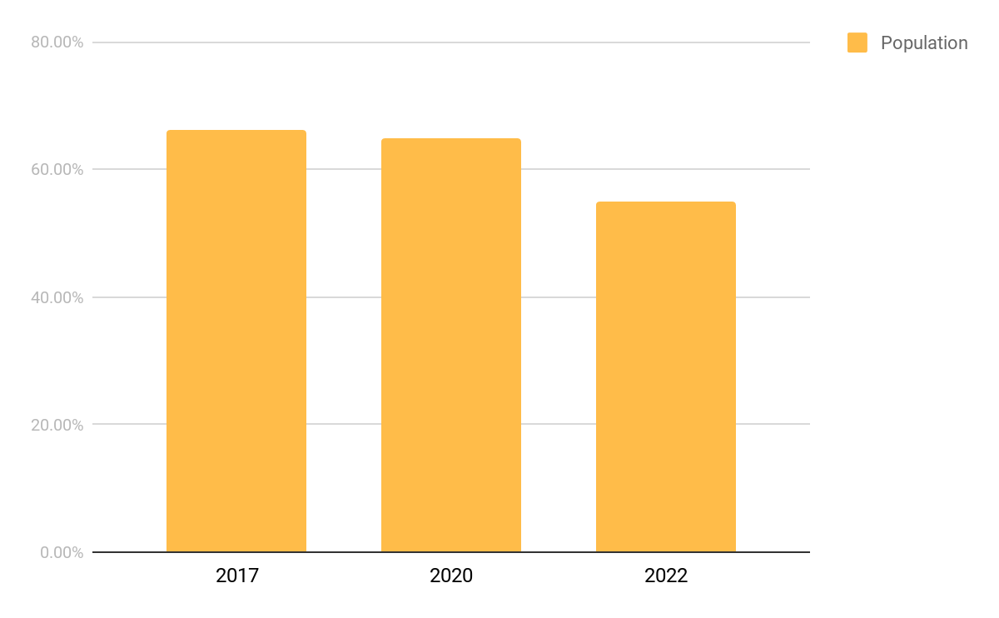
Traction
Based on the bureau’s statistics, Los Angeles has a total of 3.96 million residents as of 2017.
About 66.2% the estimated population are workers and students whose ages range between 16 years old and above.
More than 60% of this percentage are in need of reliable technology and equipment that can make daily work, school, and life (in general) more convenient.

Slide 11
Target Market
The chosen target market will be the residents of California, primarily Los Angeles. This specific group of individuals was chosen based on the following factors :
At least 500, 000 firms of Los Angeles’ population use technological devices for work.
Up to 40% to 50% of Los Angeles’ population are students who use technological devices for studying.
At least 1, 356, 311 households use technological devices on a day-to-day basis.

Slide 12
Competition
Based on a survey conducted in 2016, DZelectronix concluded that the following companies will be considered as direct competitors on the basis that they offer similar products services :
TechX Enterprises offers a variety of technological based products starting at $700
Smart Computers offers a variety of technological based products starting at $699.99
Digital Merchandise offers a variety of technological based products starting at $800

Slide 13
Alternative Solutions
The alternative solutions DZelectronix can provide are the following:
20% to 30% discount on branded items.
Warranties on all units and devices sold.
Free device check-up, cleaning, and other selected maintenance services.

Slide 14
Business Model
The company will utilize the following business model which will be implemented by early 2019:
[SPECIFY BUSINESS MODEL]
Revenue equivalent to roughly $245,000 to $250,000 will be expected by the end of 2019.

Slide 15
Schedule
The company’s schedule will be as follows :
[SPECIFY COMPANY SCHEDULE]

Slide 16
Investing
In order to officially begin, the company will require a budget estimated between $230,000.00 and $240,000.00. This amount will be collected from the following sponsors :
1. Los Angeles Investment Inc.
2. Equity Financial Insurance
3. Supreme Tech Suppliers
Each sponsor has agreed to contribute and invest at least $78,000.00 for Star Employment Agency .

Slide 17
Contact Us
Visit our office every Monday to Saturday from 9pm to 6pm at [ADDRESS].
Get in touch and contact any of these details :
[Phone Number]
[Email]
[Website]
[Social Media Account/S]

Slide 18
Thank You

