Slide 1
Biotech
Pitch deck
Presentation
This one day sale will be held at the Downtown Showroom on February 14, 2021 from 10am to 6pm. Tickets start at $39.99 each and will entitle attendees to an 80% discount on purchases worth $2000 and above.

Slide 2
EMMAN IORY BIOTECH

Slide 3
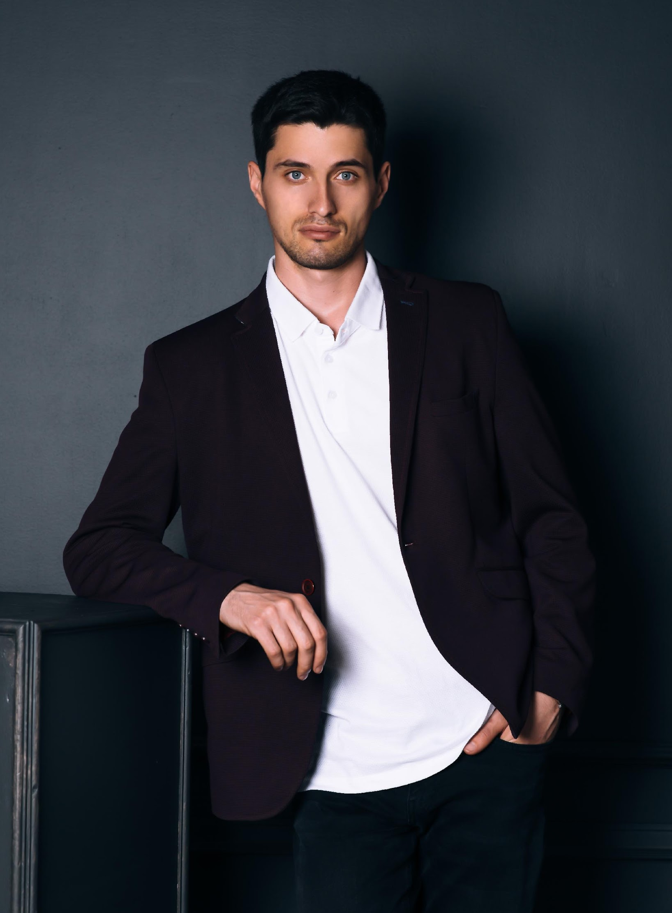
Gavin Hudson
The Company
Founder & CEO
I am Gavin Hudson and I welcome you to Emman Iory Biotech.
This company is the fruit of all my struggles, pain and happiness in life. I am more than happy to introduce you the soon to be number 1 digital marketing agency in the country - Prime Solutions Agency.
The previous years gave us a glimpse of what this agency can claim and achieve. Now, this year holds a lot more challenges and expectations awaiting us. I am grateful to announce the new improvement plans and carefully planned events for all of our clients.
As a thanks to our loyal clients, we developed and organized events that would give them access to the best that we as a company have to offer. These events will provide them with amazing prices, discounts and gift coupons.
I believe that Prime Solutions Agency will continue to strive further towards development and success in the digital marketing industry.

Slide 4
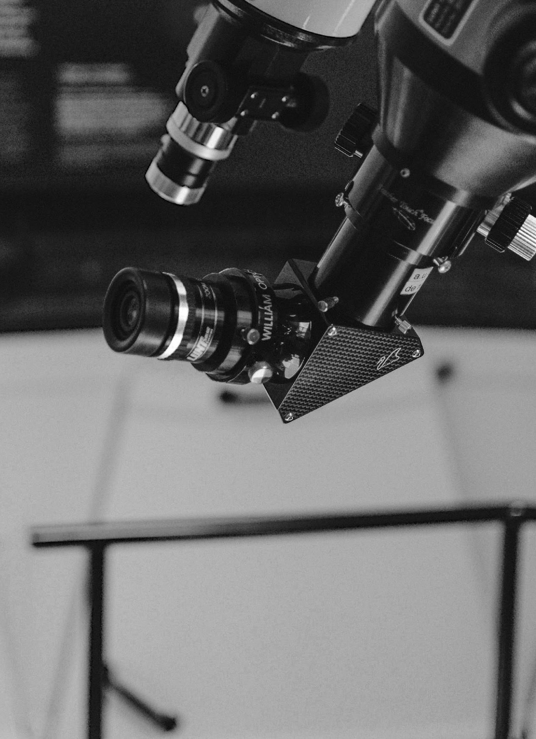
What do
Costumers Want?
The Company
01
This one day sale will be held at the Downtown Showroom on February 14, 2021 from 10am to 6pm. Tickets start at $39.99 each and will entitle attendees.
More Value
02
More Clients
Use the elements of value as a compass when deciding where to add value to their propositions.
03
More Profit
Use the elements of value as a compass when deciding where to add value to their propositions.

Slide 5
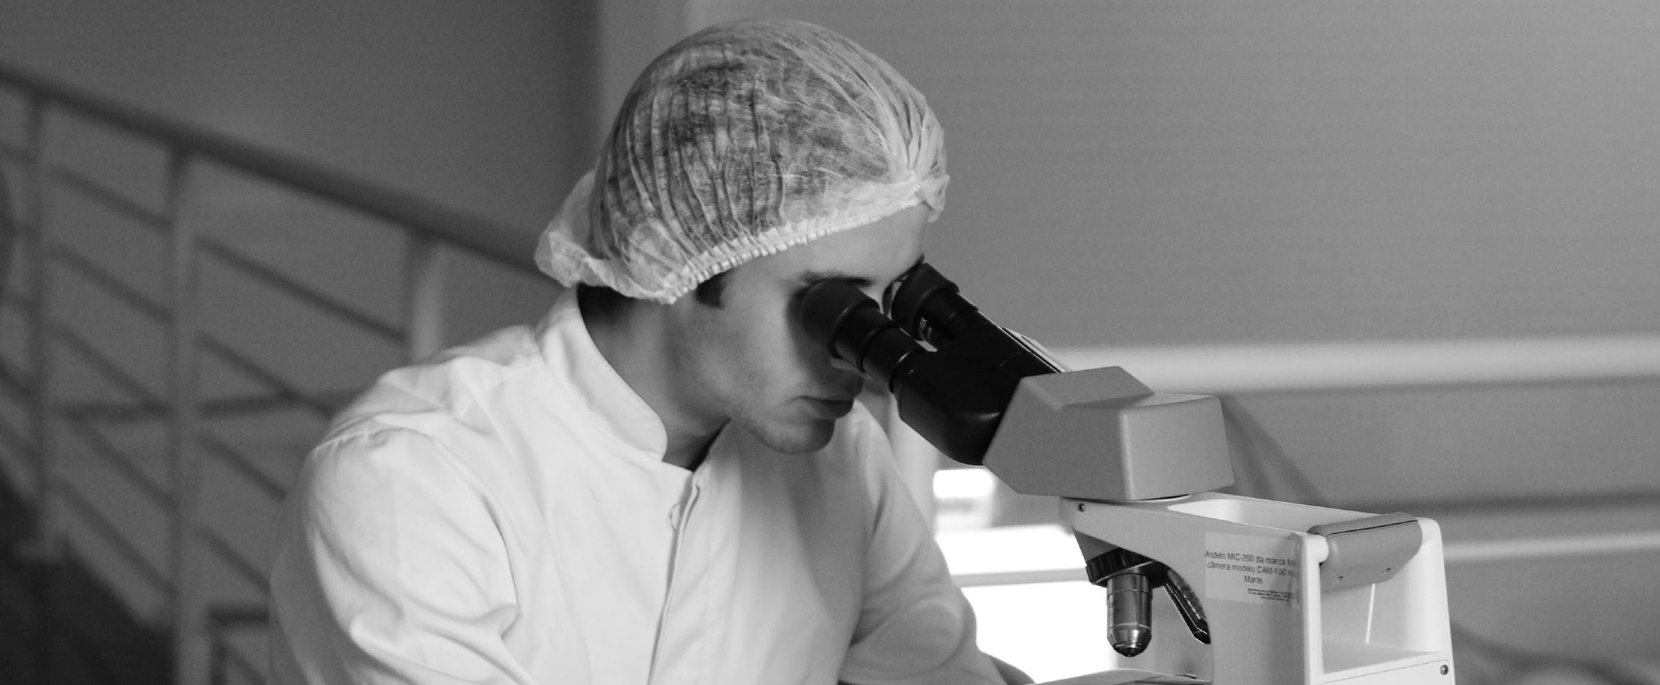
“Prime Solutions Agency is a company that is passionate in providing products and services geared towards those who need help in the marketing department.”
-Gavin Hudson, 59, Founder & CEO

Slide 6
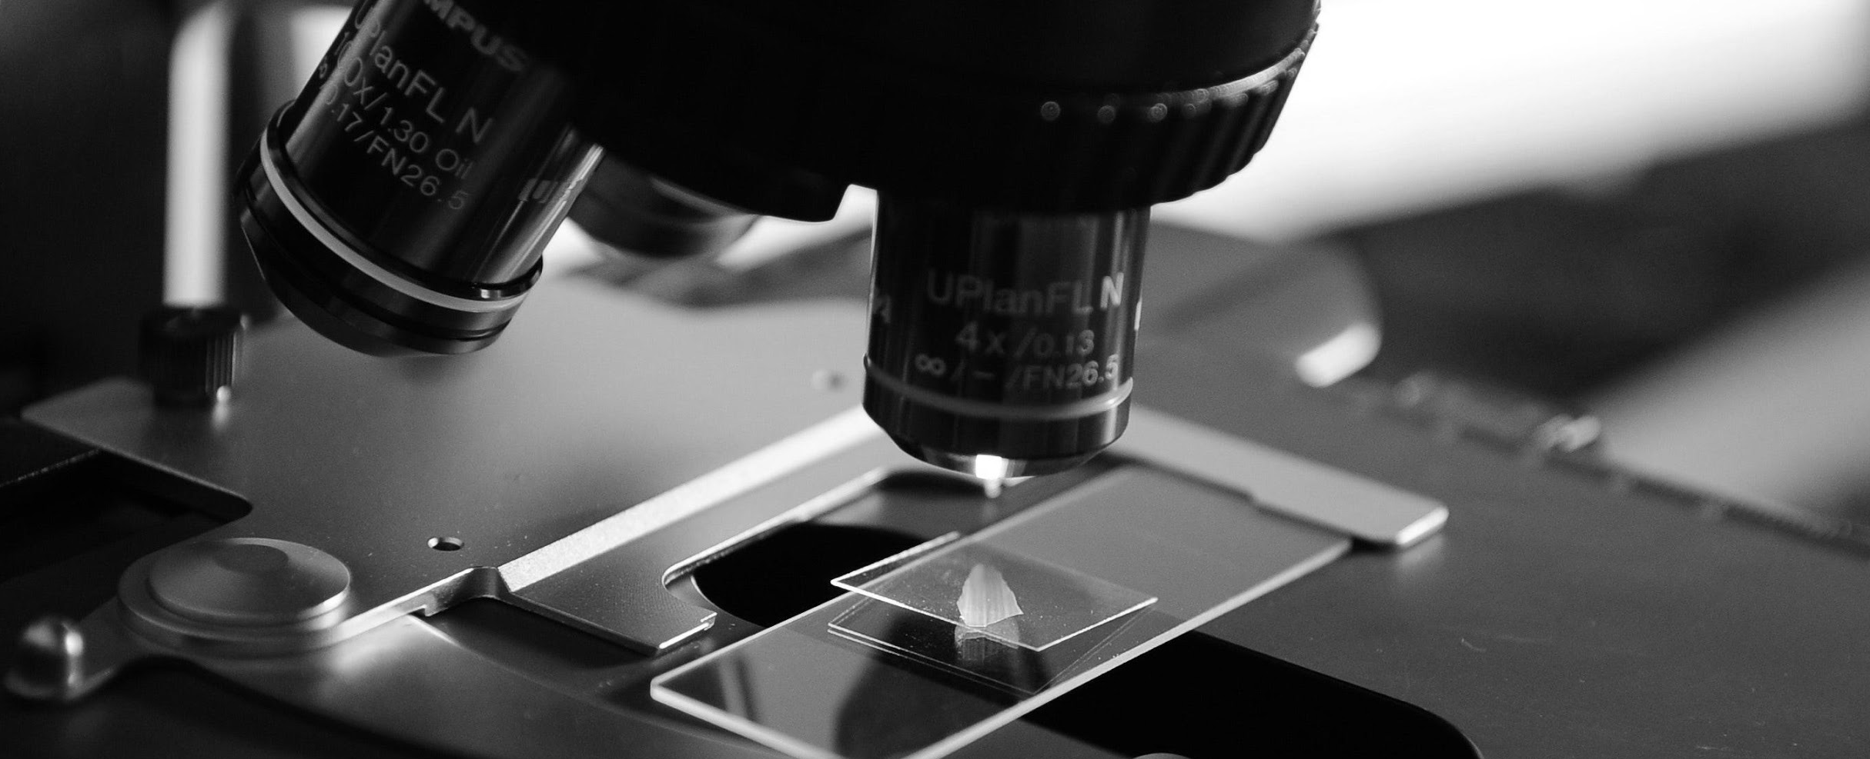
History
First established in 2005 by Gavin Hudson, EMMAN IORY BIOTECH is a proud provider of superior digital products and services. With over 13 years of experience in the digital marketing industry, Prime Solutions Agency currently has 3 fully operating branches in New Mexico, Illinois and Seattle.

Slide 7
The Company
Management
The previous years gave us a glimpse of what this agency can claim and achieve. Now, this year holds a lot more challenges and expectations awaiting us. I am grateful to announce the new improvement plans and carefully planned events for all of our clients.
Iory Williams
Hailey Bush
Chad Mufeills
Chief Executive Officer
Biotechnologist
Tech Consultant

Slide 8
OFFERS AND SERVICES

Slide 9
Full Service
Biotechnology
Our Services
We provide branding from the inside-out, so when it comes to creating a logo or other elements, we've got you covered.
Effective social media success takes effective planning and creative thinking to drive customers to buy.
Our expertise in consulting and training, for profit or not-for-profit businesses, allows us to be your guide.

Slide 10
Biological System
Our Services
From procurement and cost management to supply chain efficiency and digital transformation, Bain works with companies in all industrial sectors to solve a broad range of management challenges. We help companies generate real results today and build a strategy that will endure well into the future.

Slide 11
EXECUTION

Slide 12
Execution
Strategy
From procurement and cost management to supply chain efficiency and digital transformation, Bain works with companies in all industrial sectors to solve a broad range of management challenges. We help companies generate real results today and build a strategy that will endure well into the future. Combine traditional and digital lean techniques to achieve new levels of performance and efficiency, on the shop floor and beyond.

Slide 13
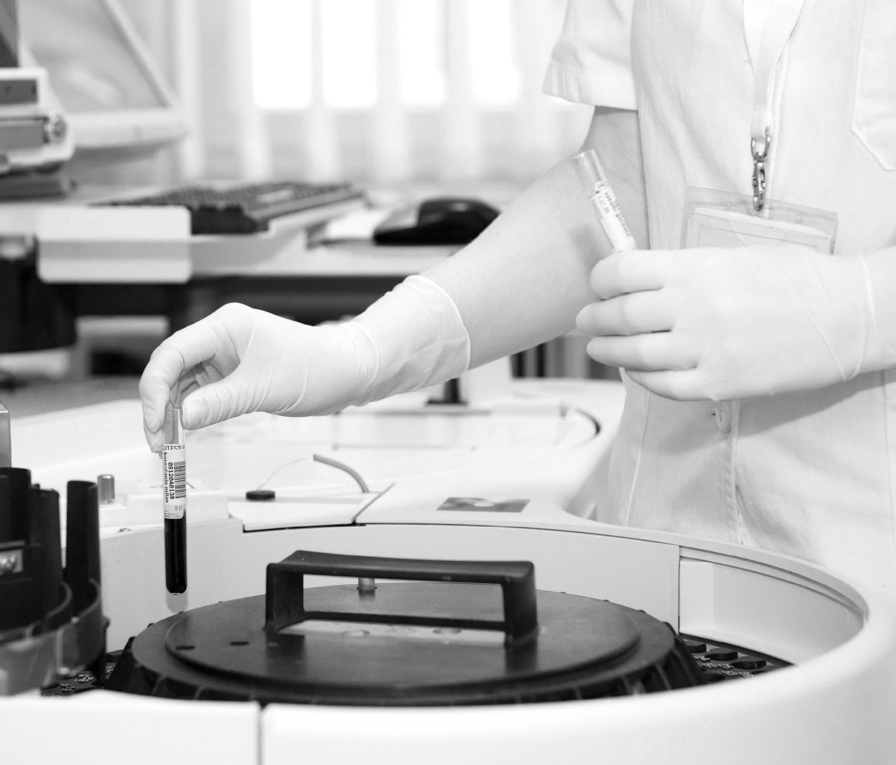
Sustainability
Execution
Sustainability efforts should be anchored in business fundamentals, demonstrate a clear return on investment, and be firmly embedded within your strategy and operations. We can help you address critical issues related to sustainability strategy, the environmental and social impact of operations, stakeholder engagement, and sustainability-related growth and cost opportunities. Our teams specialize in helping the efficiency, on the shop floor and beyond.

Slide 14
Main Goal
Execution
Emman Iory Biotech commits itself to provide its clients with effective, efficient and reliable products and services for digital marketing developed to help boost every clients’ respective brand. This means working with management and staff to ensure every detail of “the experience” a client or customer may have meets and delivers on any promises made via the creative process. It also means being an integral part of the ongoing process, successes and failures.

Slide 15
OPERATIONAL PLAN

Slide 16
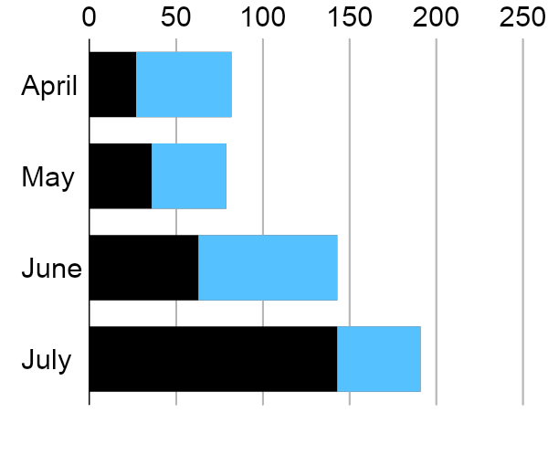
Operational Plan
Overview of Growth
60% increase in annual profits as of May 2021.
70% increase in satisfaction with developed website templates as of March 2021.
45% increase in clientele base as of March 2021.

Slide 17
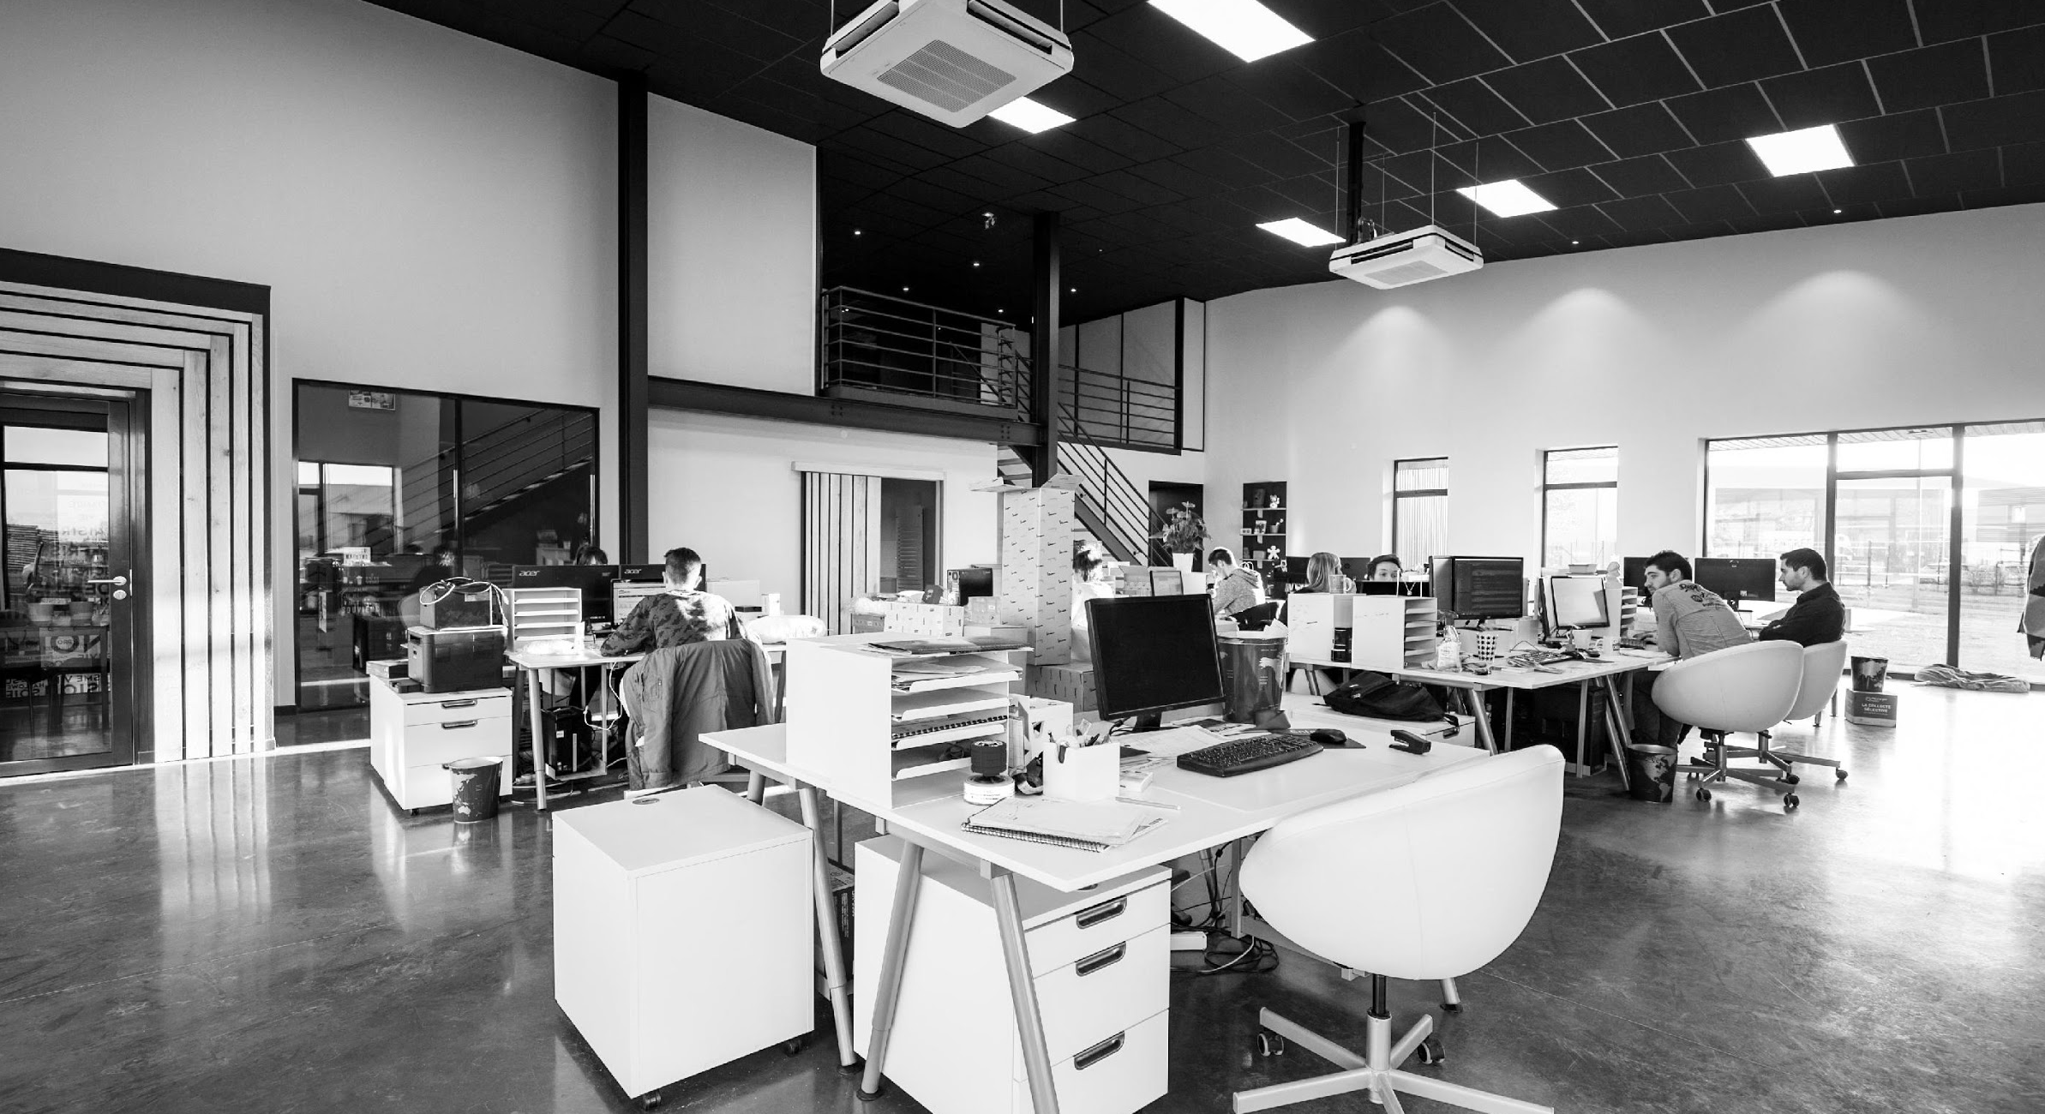
Operational Plan
Pursue Investment
Emman Iory Biotech commits itself to provide its clients with effective, efficient and reliable products and services for digital marketing developed to help boost every clients’ respective brand. This means working with management and staff to ensure every detail of “the experience” a client or customer may have meets and delivers on any promises.

Slide 18
START-UP SUMMARY

Slide 19
Start-up Summary
Startup
Requirements
Start-Up Expenses
Rent - 5 Months $20,000
Advertising $15,000
Legal Fees $5,000
Staff Training $5,000
Insurance $5,000
Other $0
Total Start-Up Expenses
$50, 0000

Slide 20
TESTIMONIALS

Slide 21
Testimonials
Sophia Holiday, 31, Biotechnologist
Ben Aaron, 41, Scientist
The place where champions are built, Emman Iory Biotech consistently provides me the most effective exercises to maintain my physique. Definitely the best place for all living matter lovers!
As a stock broker, fitness has never been my priority because of my busy schedule. That is, until Emman Iory Biotech showed me the reason why I should value my physical health. They have a various worthwhile & effective programs for people who wish to attain their dream body.

Slide 22
THANK YOU!
EMMAN IORY BIOTECH
(000) 111 2222 |dm@emmaniorybiotech

